Slide 1
Applications of AI in drug design
Kenneth Huang
Šali & Echeverria Labs
University of California, San Francisco

Slide 2
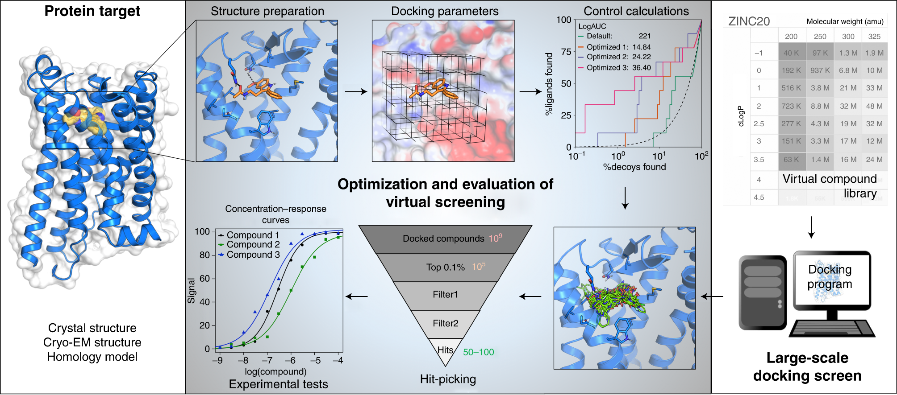
From desktop to experimental applications
Bender, B. J.; Gahbauer, S. et al. A Practical Guide to Large-Scale Docking. Nat. Protoc. (2021)

Slide 3
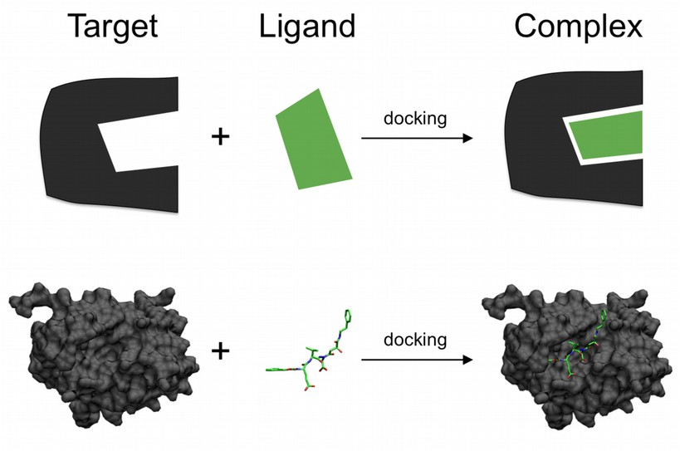
Molecular docking: searching for small molecule design

Slide 4
Drug design becomes an ennumerative problem based on increasing number of combinations
Hit Expansion

Slide 5
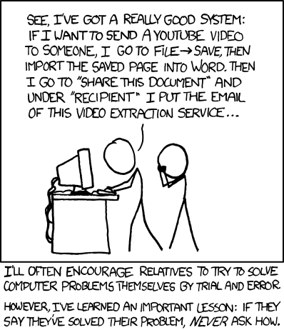
Does the solution fit the problem?

Slide 6
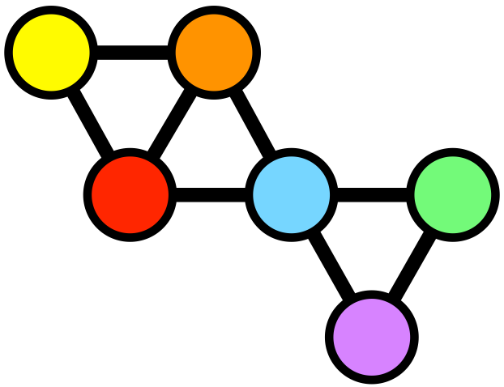
Machine learning: pattern searching and dimensional reduction of the data
Bait
AP-MS
Interaction network (2,985 proteins)
 | 1 | 2
1 | 0 | 1
2 | 1 | 0
2
1
2
1
Score potential edges (4.5 million)
Adjacency matrix (NxN)
‹#›
Notes:
For simplicity I would consider a 0,1 adjacency matrix and I would make sure it agrees with the diagram to the right
Model is just AP-MS, but the benchmark system is the physical models to verify the actual network
Bait+prey network, provides basis for physical interaction network plus AlphaFold predictions to appro

Slide 7
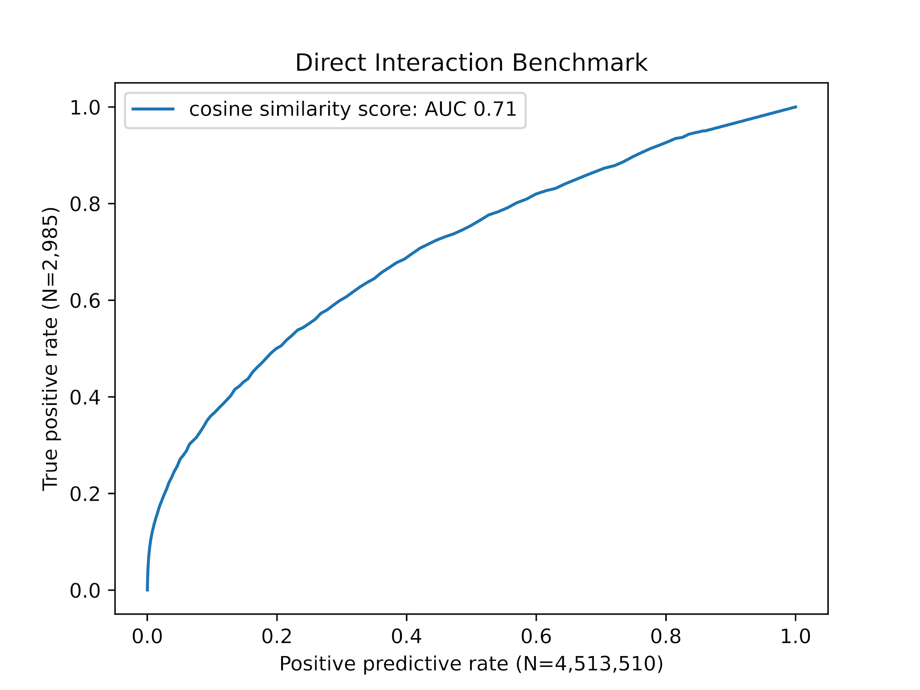
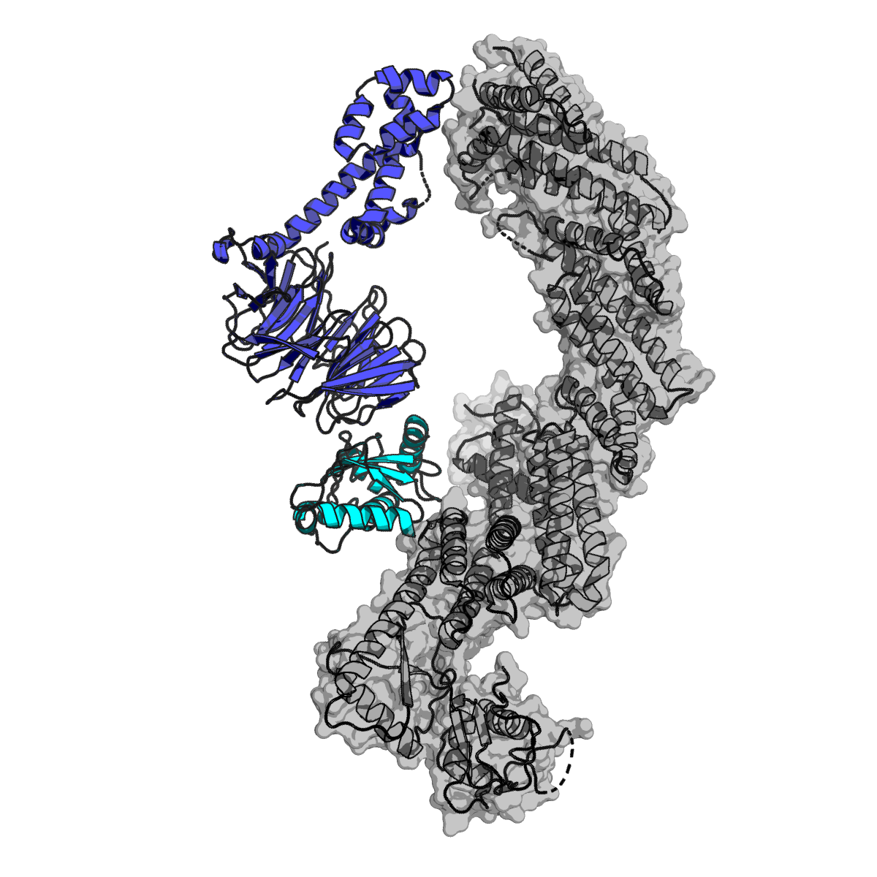
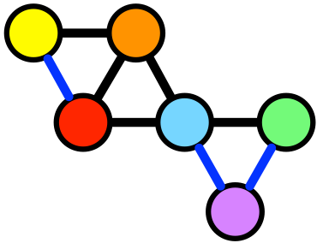
Machine learning: pattern searching and dimensional reduction of the data
Benchmark (direct interactions; PDB)
AUC≤0.5 → random
Biological networks
True Positive (PPIs)
Predicted Interactions
Aji Palar
Notes:
AP-MS details association, but does not describe interfaces
Benchmark indicates that AP-MS can also offer insight into prey-prey as well as bait-prey from PDB search; benchmark has direct interactions and co-complex interactions
Super Imposed Model of A3G vis complex
CUL5/RBX2 complex (3DPL, 2ECL, 2WZK)
A3G-Vif Complex (4N9F)
Sequence alignment shows targeted lysines for ubiquitination
A3G abundance was restored after mutating lysines
Mono and poly ubiquitination was reduced upon mutation
Cosine similarity score.
Y axis is the true positive rate of direct protein interactions
X axis is the total number of predicted interactions
An AUC of 0.5 is random (Null model is hypergeometric - sampling edges with out replacement from population of 2,985 ‘true’ edges of ~4.5 million possible edges).

Slide 8
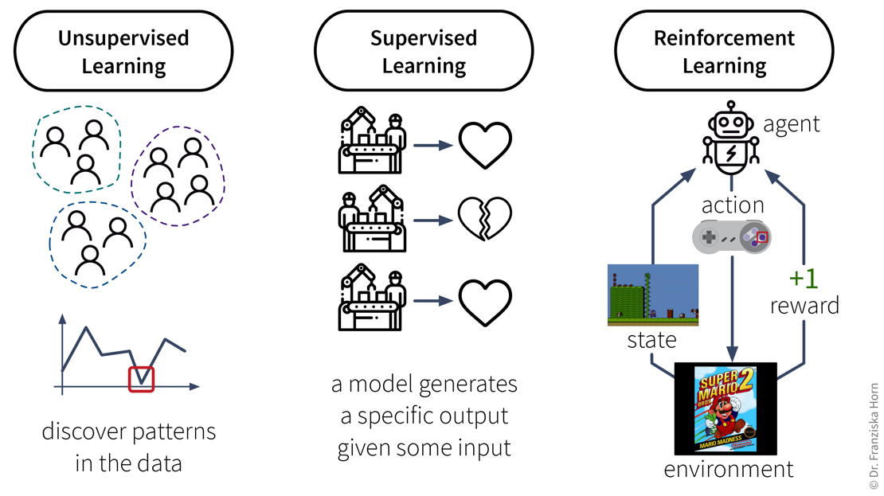
The triad of machine learning approaches
Notes:
unsupervised -- no training, no labels, just examining the structure supervised -- training, labels, you tell how wrong it is (NN) reinf - no dataset, environment, agent (NN)

Slide 9
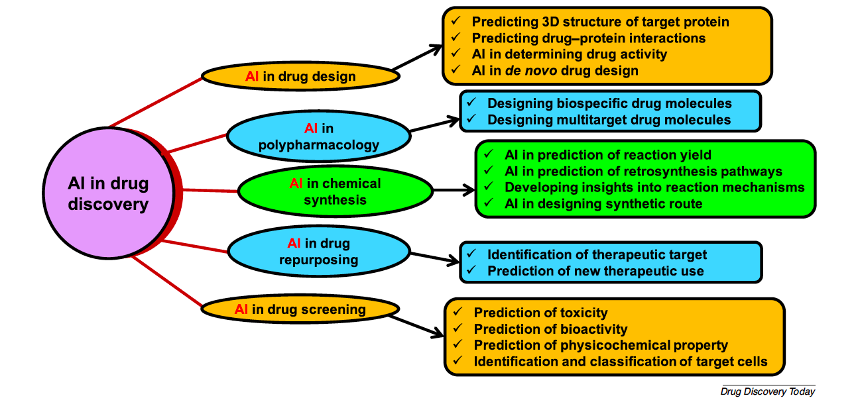
Drug design is a problem/environment largely denoted by a large amount of noise

Slide 10
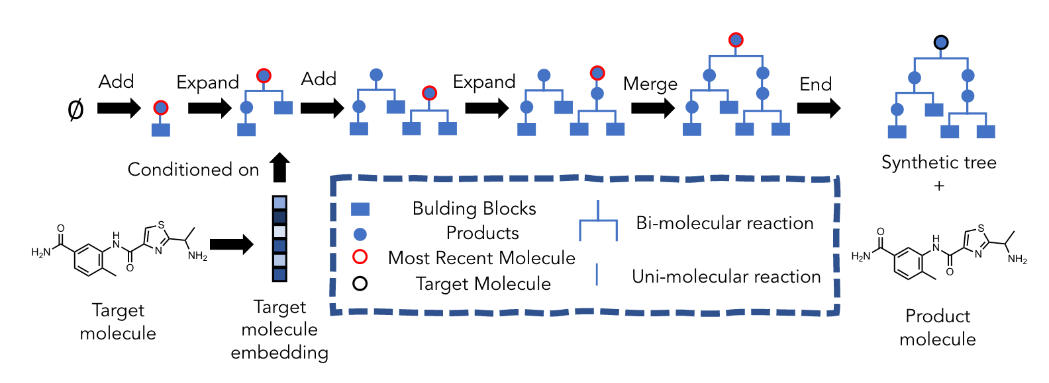
De novo drug design by exploration of alternative synthetic pathways
Gao, W.; Mercado, R.; Coley, C. W.. arXiv March 12, 2022.
Notes:
(1)
Gao, W.; Mercado, R.; Coley, C. W. Amortized Tree Generation for Bottom-up Synthesis Planning and Synthesizable Molecular Design. arXiv March 12, 2022. http://arxiv.org/abs/2110.06389 (accessed 2022-08-10).

Slide 11
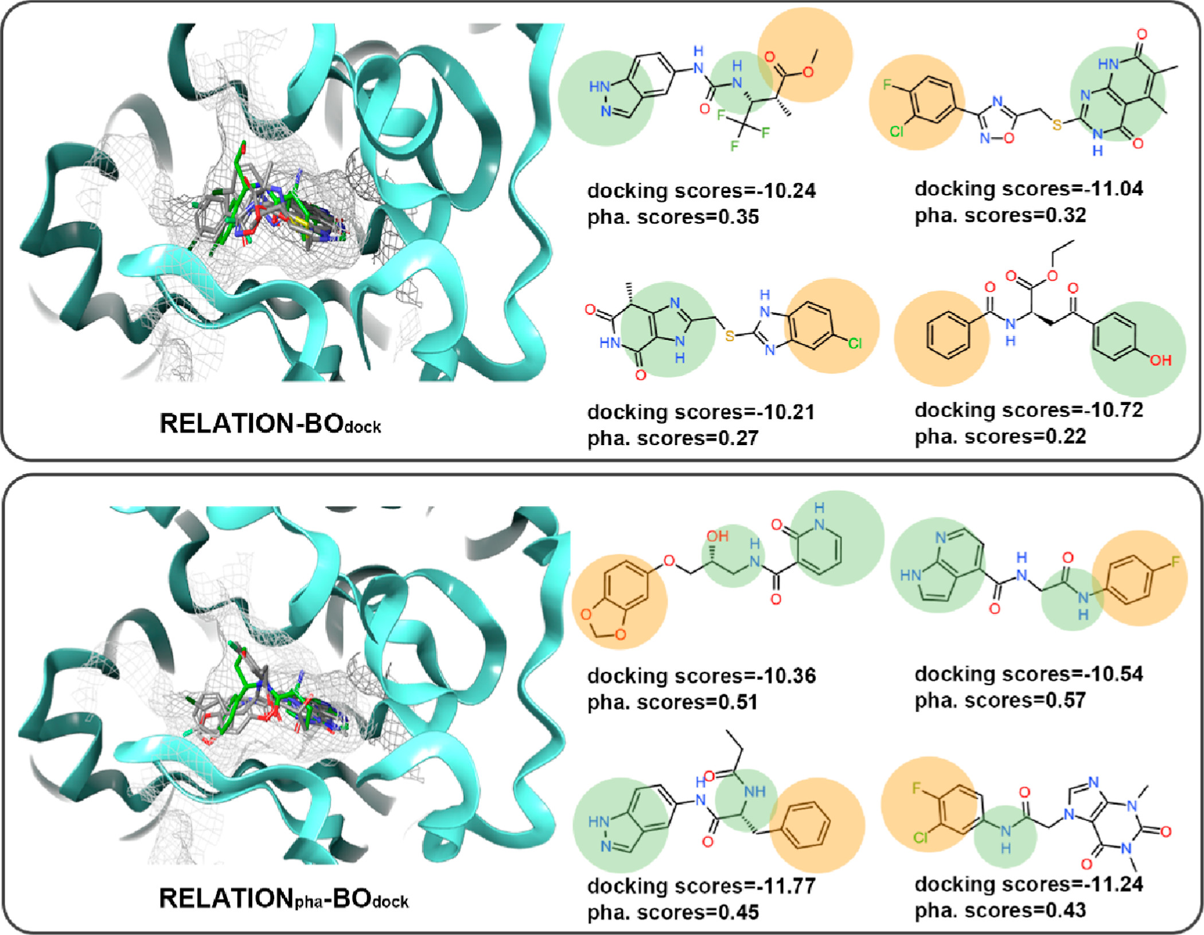
De novo drug design by exploration of alternative synthetic pathways
RELATION: A Deep Generative Model for Structure-Based De Novo Drug Design
Wang, M. et al. J. Med. Chem. 2022, 65 (13), 9478–9492.
https://github.com/micahwang/RELATION

Slide 12
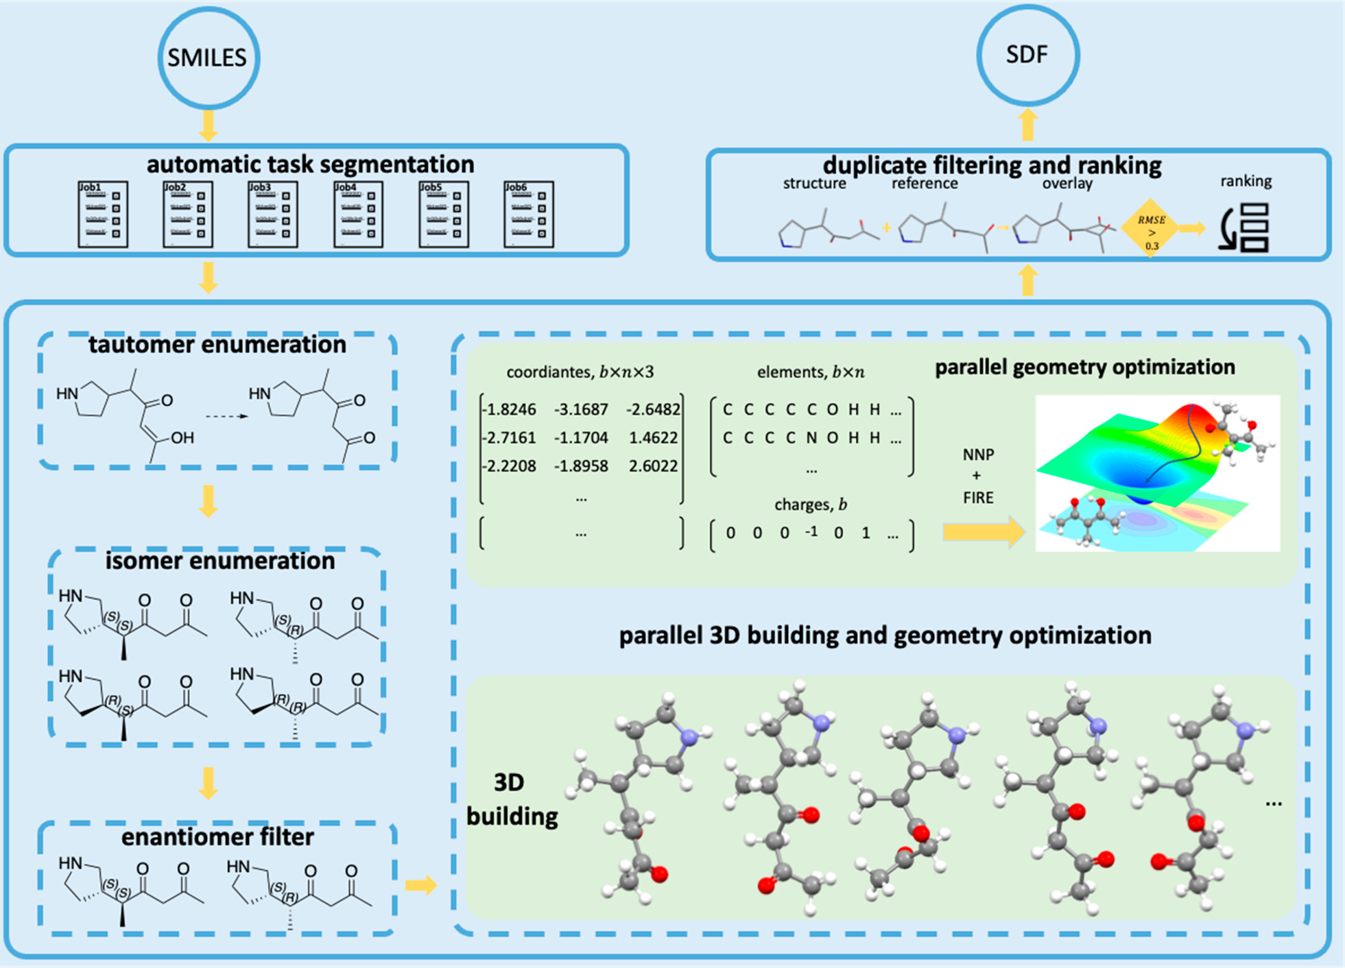
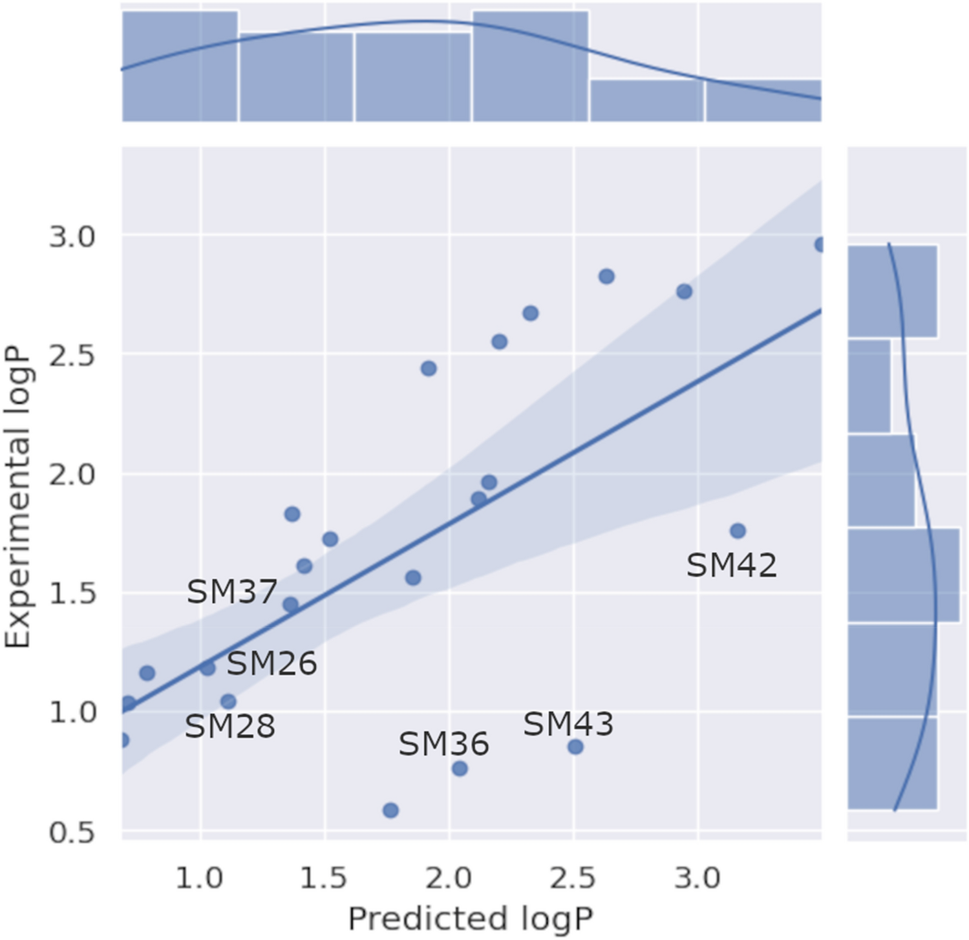
3D conformer generation to assist in prediction of molecular properties
Auto3D: Automatic Generation of the Low-energy 3D Structures with ANI Neural Network Potentials
Liu, Z.; Zubatiuk, T.; Roitberg, A.; Isayev, O. J. Chem. Inf. Model. 2022, 62 (22), 5373–5382.
https://github.com/isayevlab/Auto3D_pkg
Lenselink, Eelke B., and Pieter FW Stouten. Journal of Computer-Aided Molecular Design 35, no. 8 (2021): 901-909.
Notes:
Olexandr Isayev
2002 M.S. in Chemistry, Dnepropetrovsk National University, Ukraine

Slide 13
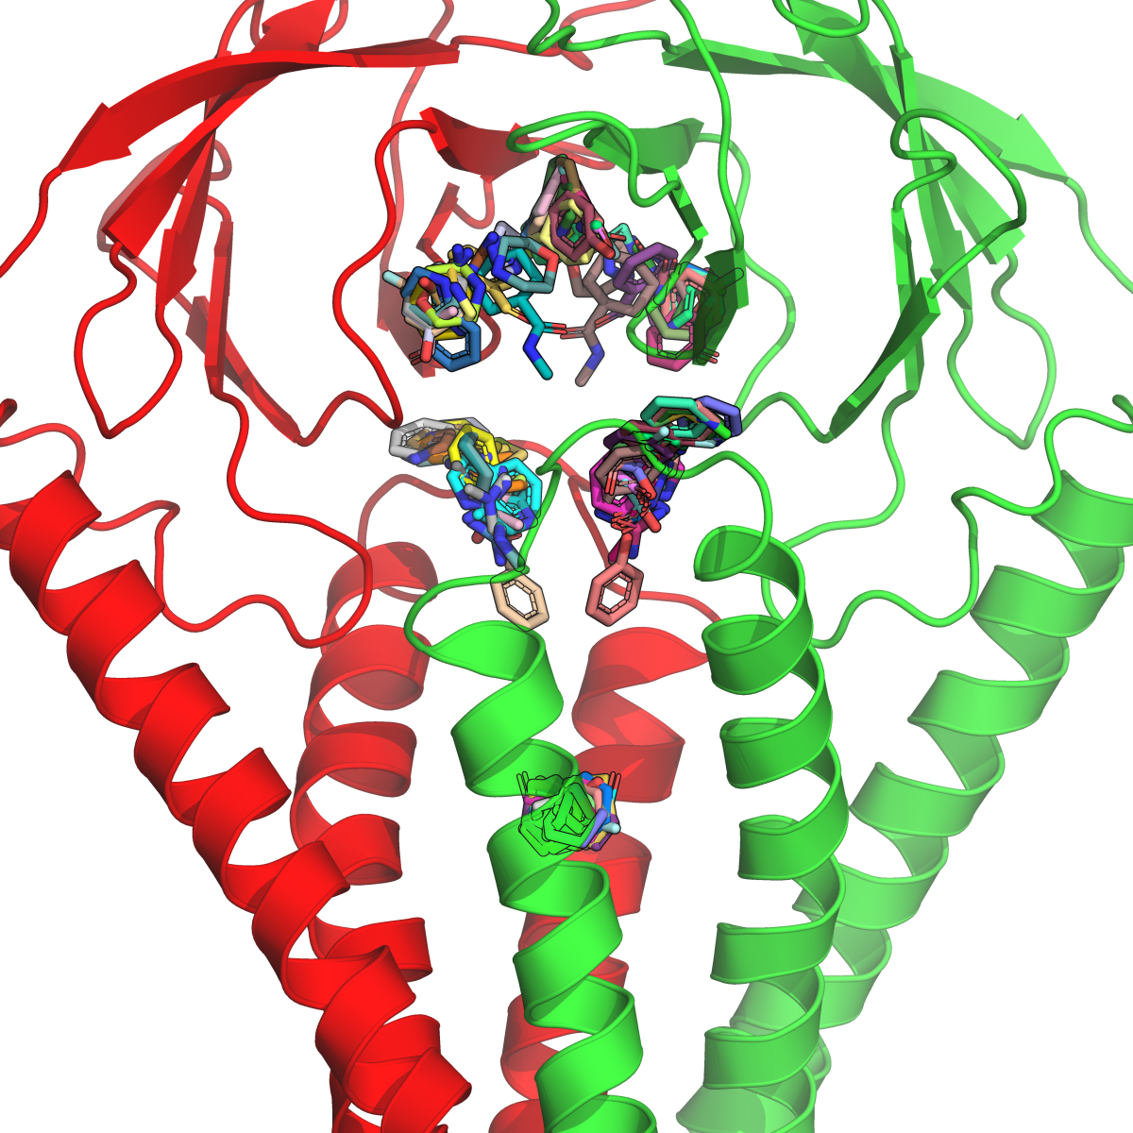
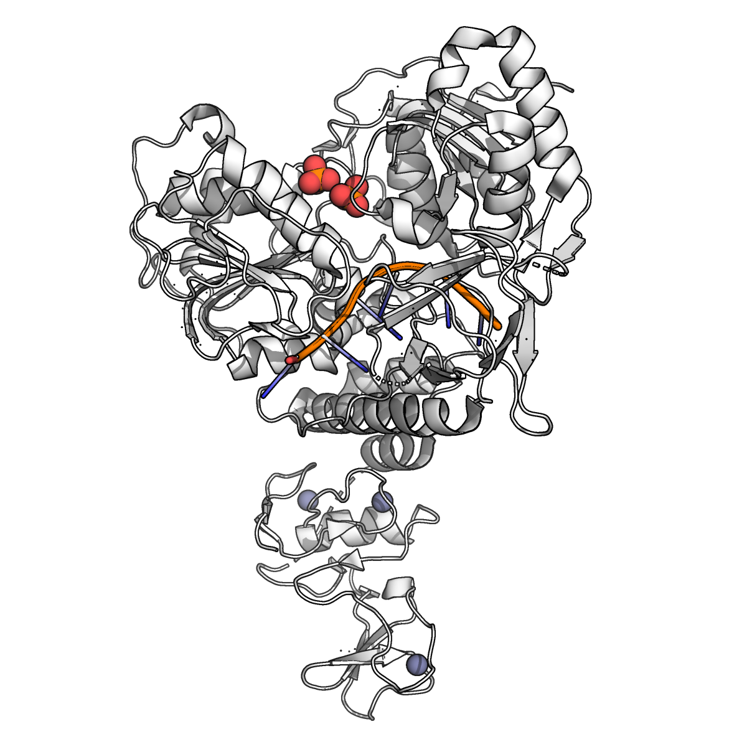
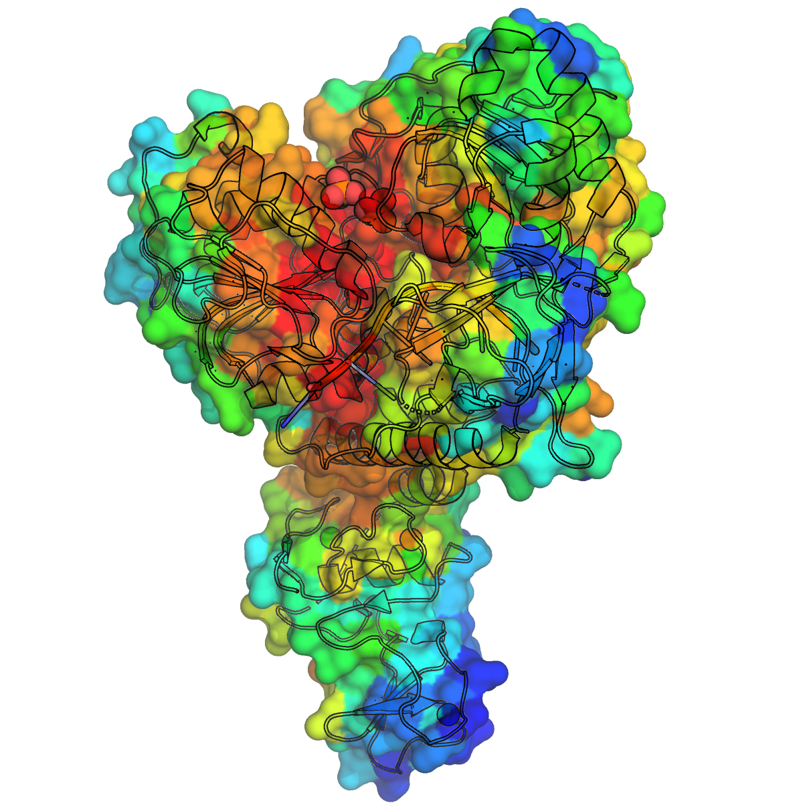
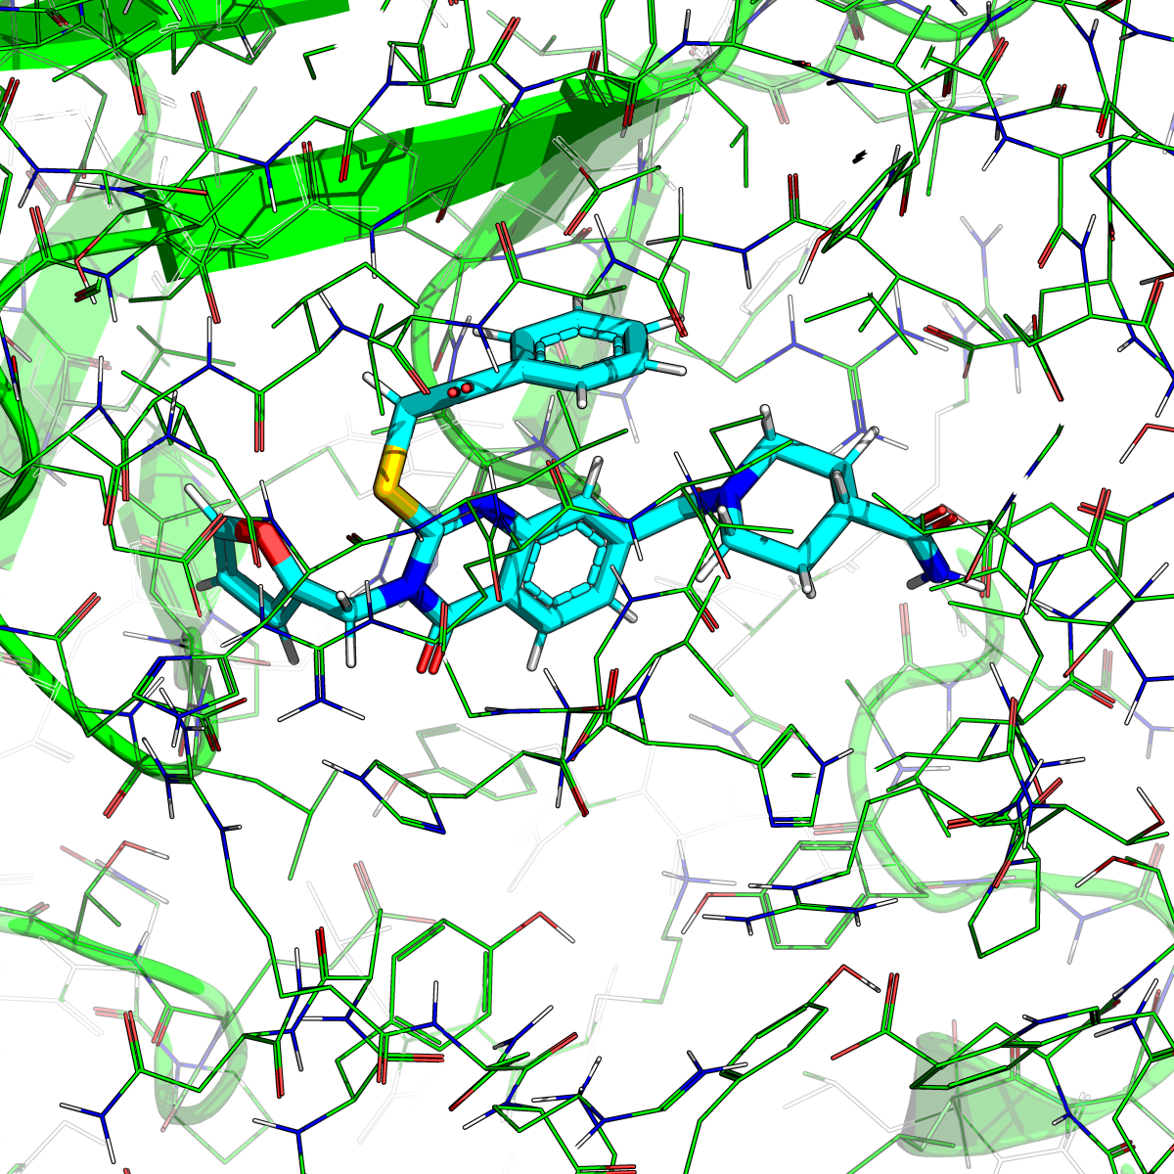
Case 1: Plurality of binding sites
Multi-functionality of viral proteins ⇒multiple pockets
Identify ligand pocket
Verify activity with assays
Optimize ligand design
J. F. Hultquist & K. J. F. Satchell

Slide 14
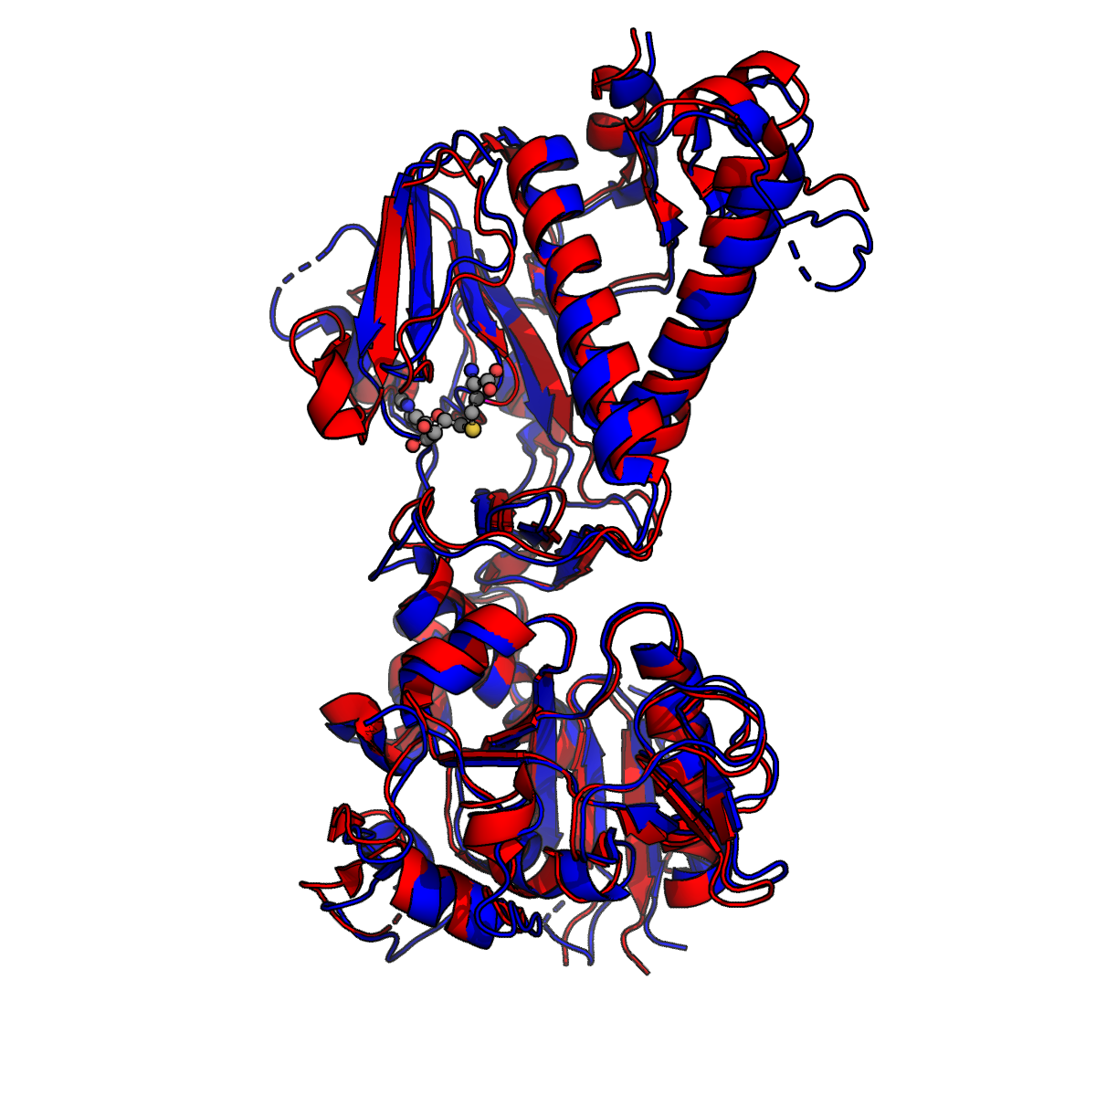
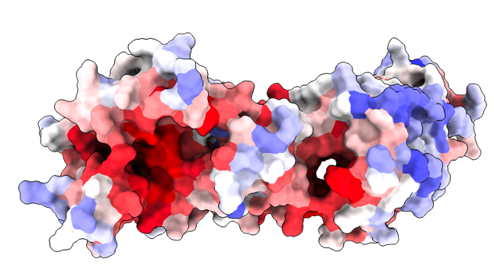
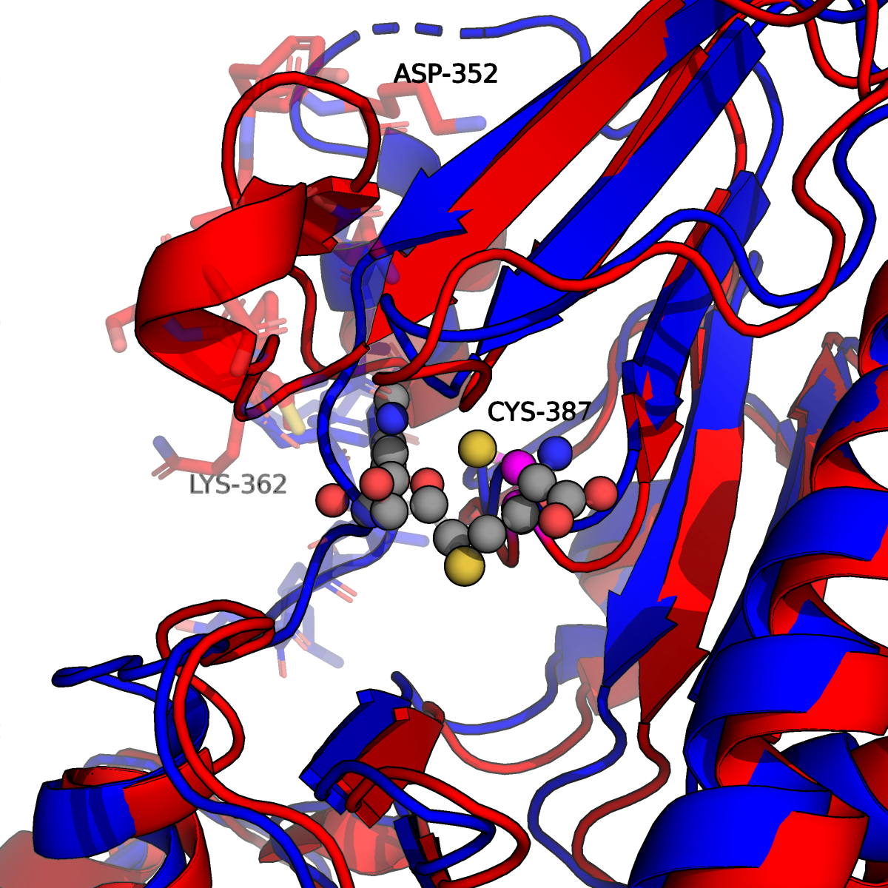
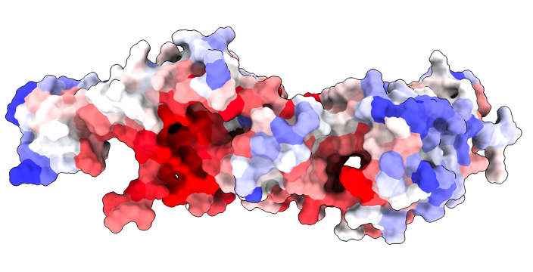
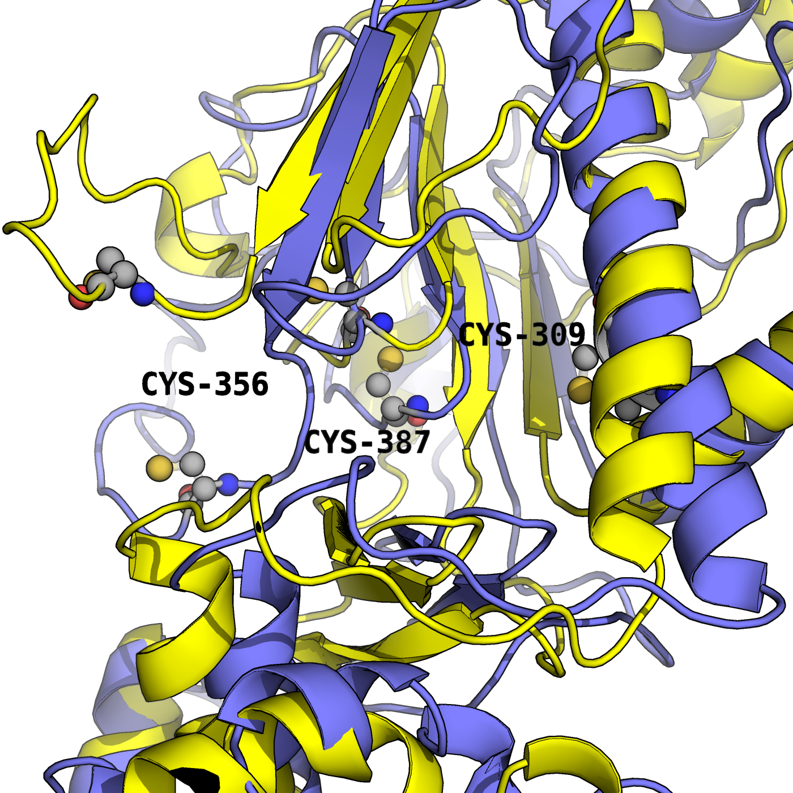
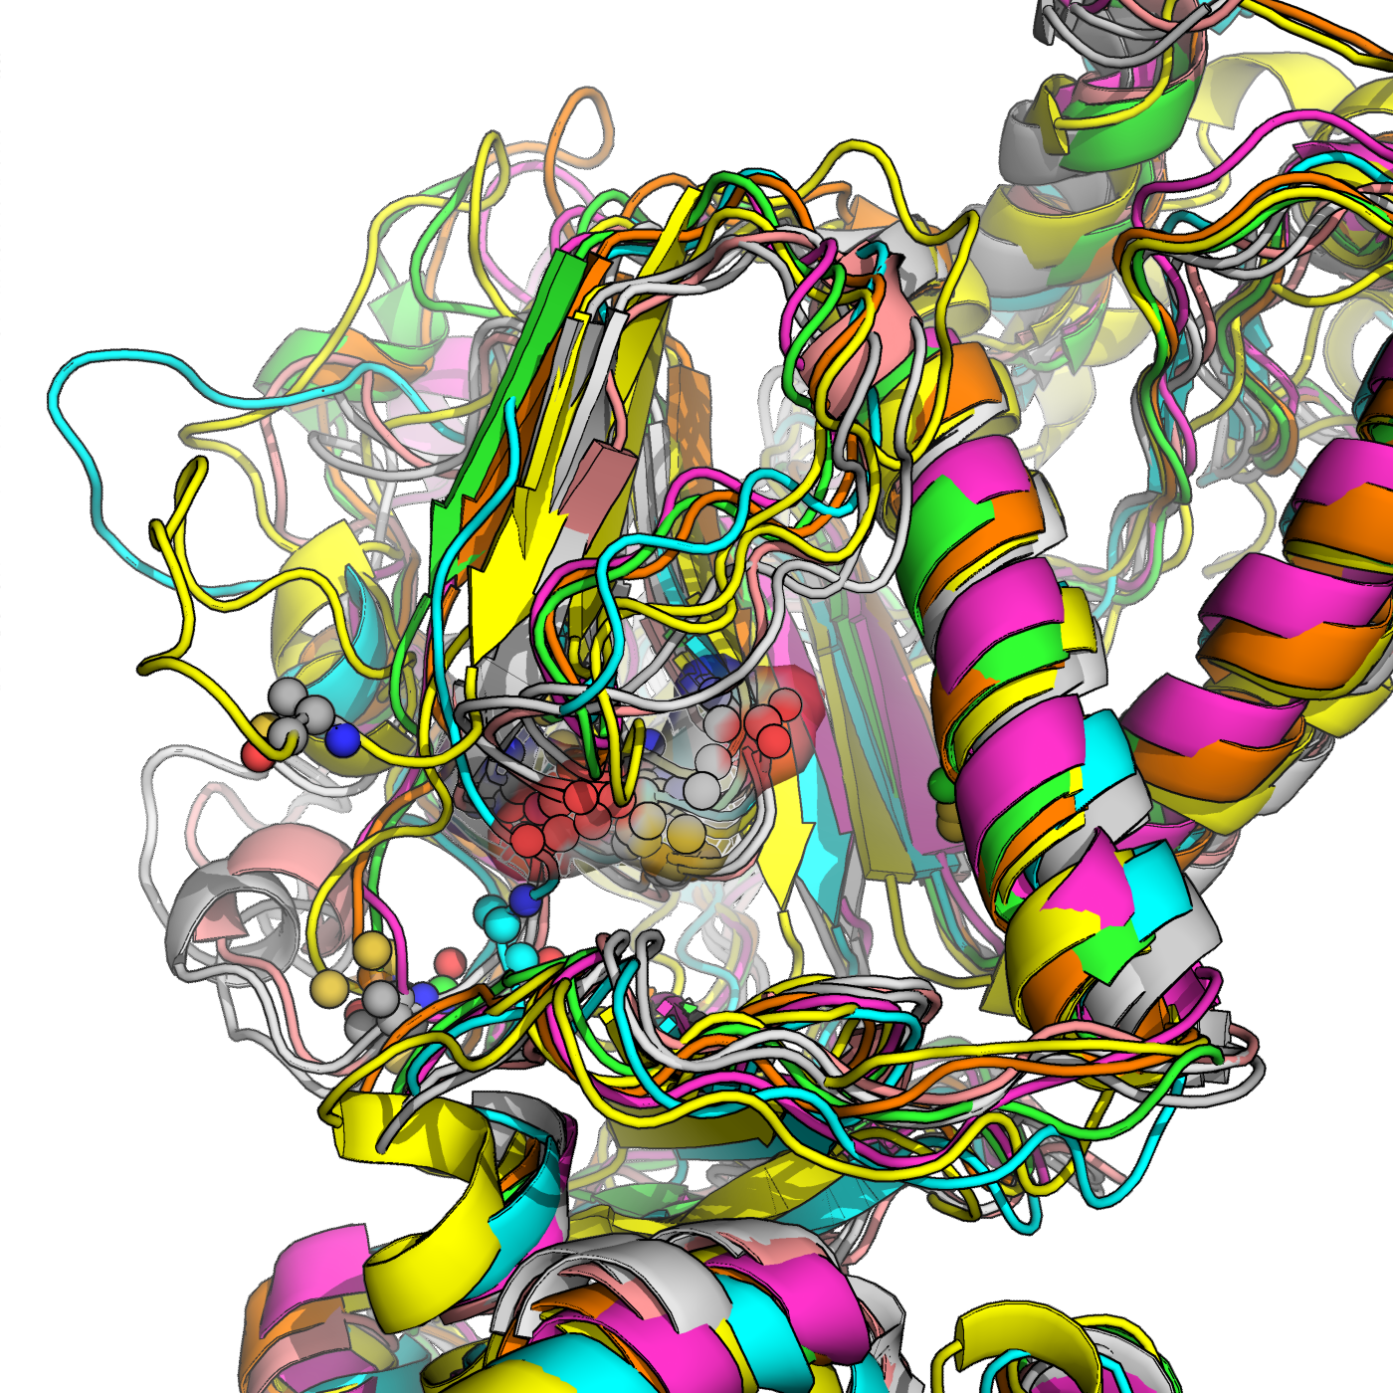
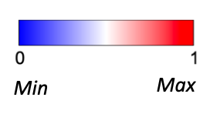
Case 2: Multi-state proteins increase search space for ligand discovery
Additional conformations in ligand pocket(s)
Expanding range of potential ligand pockets
PDB: 7QGI (-SAH), 7R2V (+SAH)
Surabhi Rathore; Fujimori; Vedadi, Shoichet Labs

Slide 15
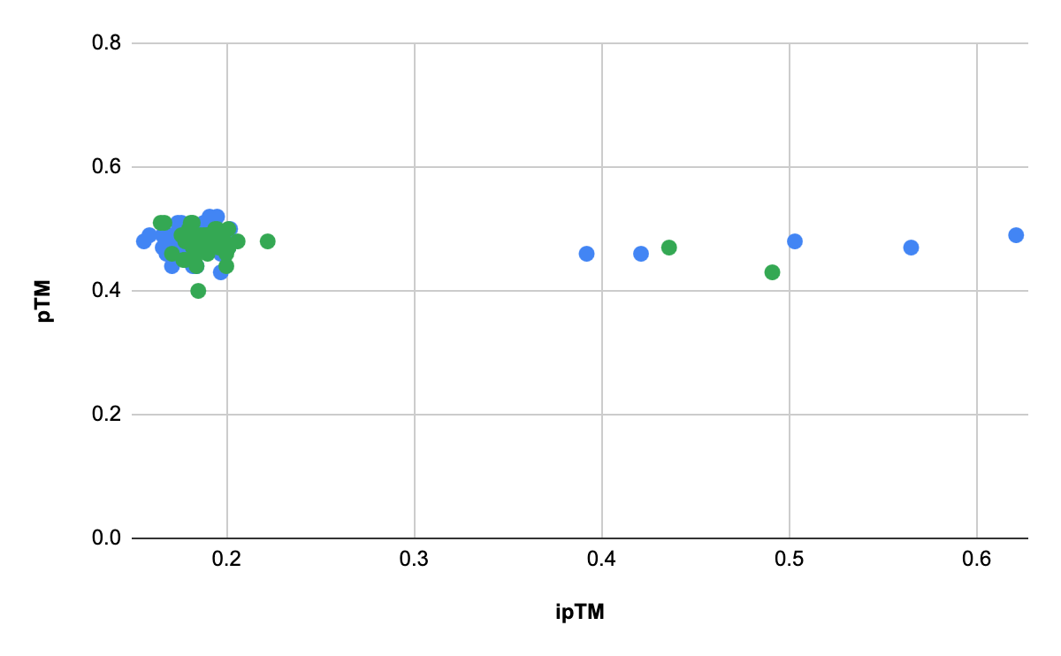
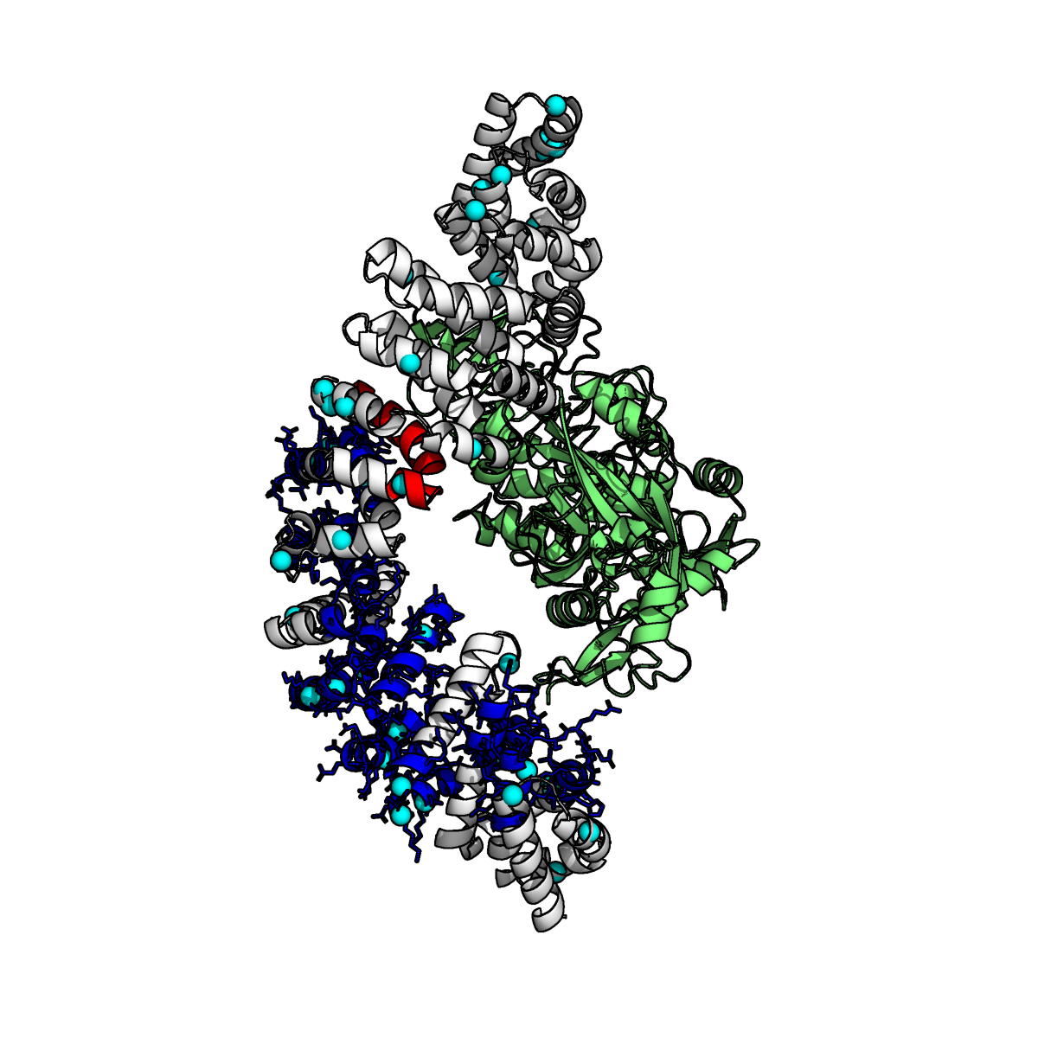
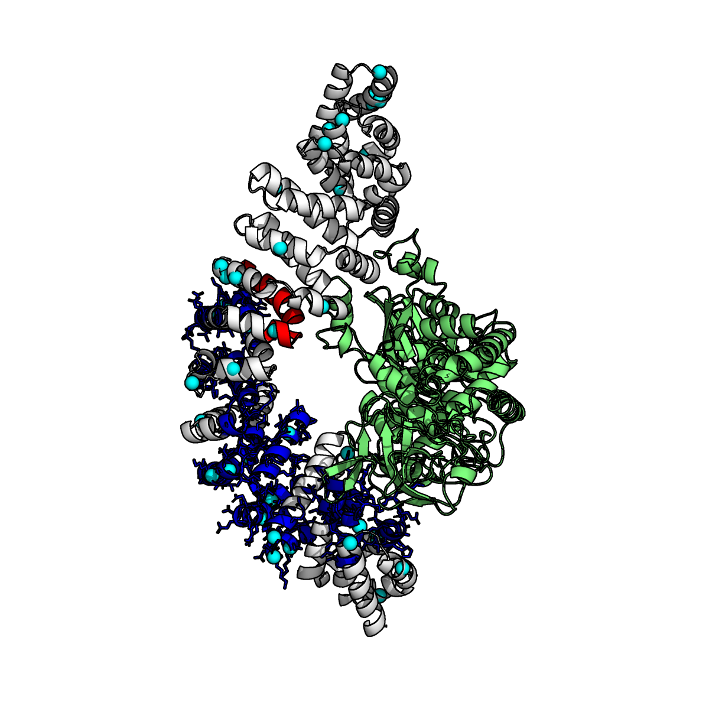
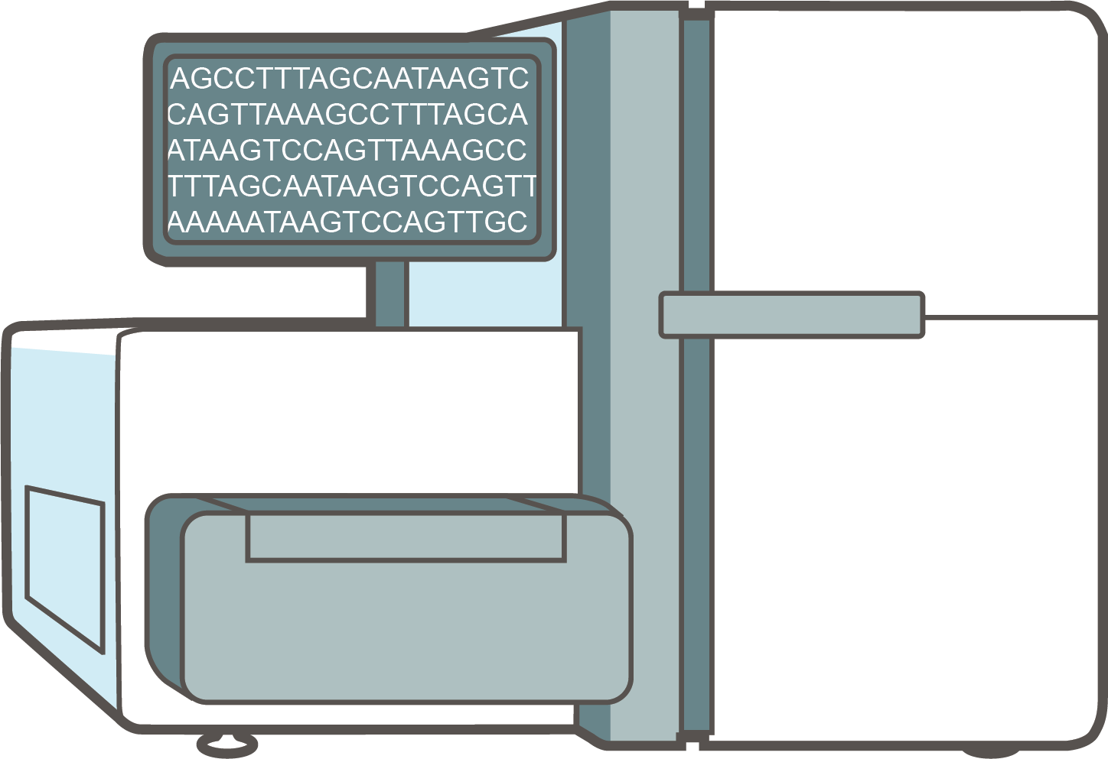
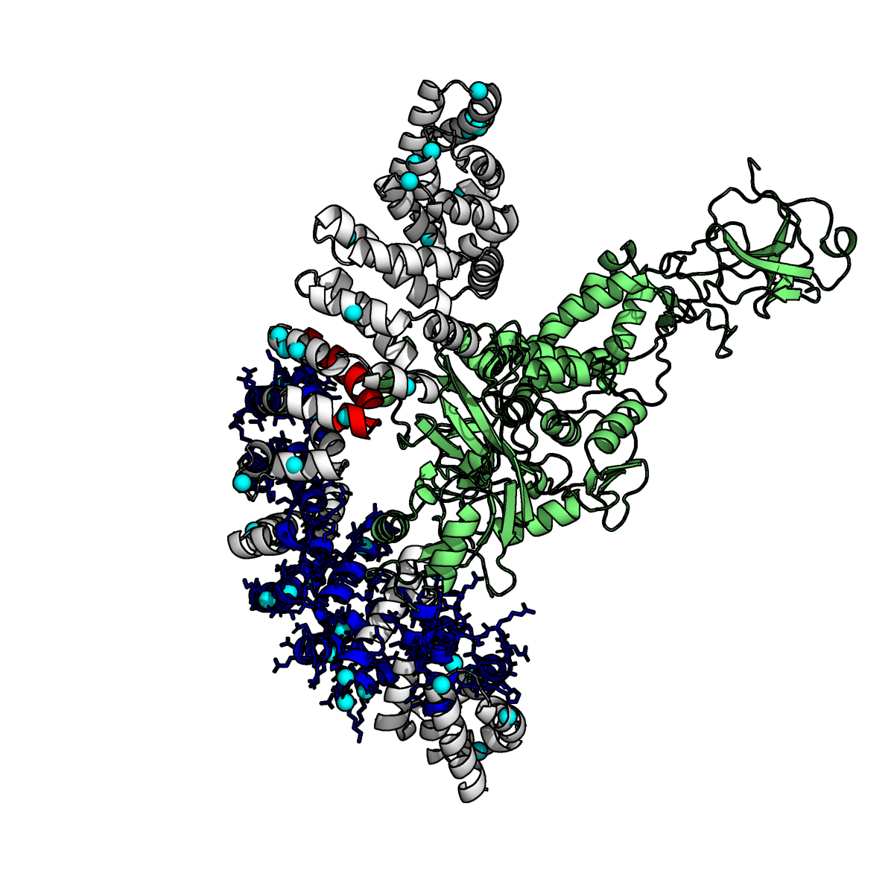
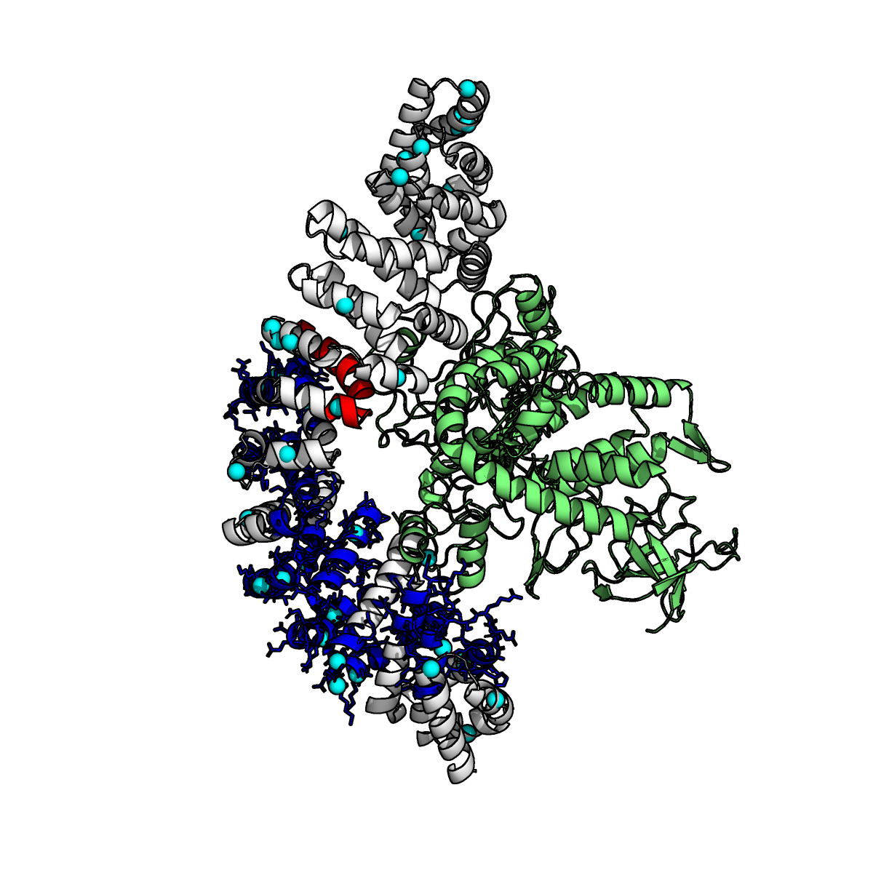
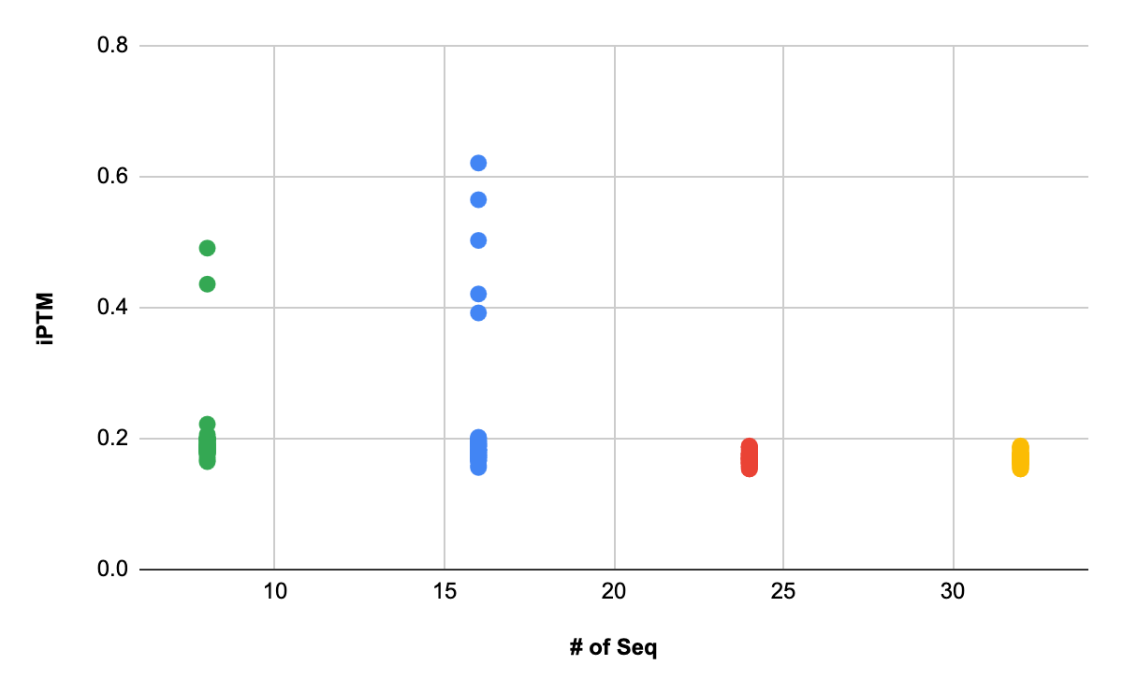
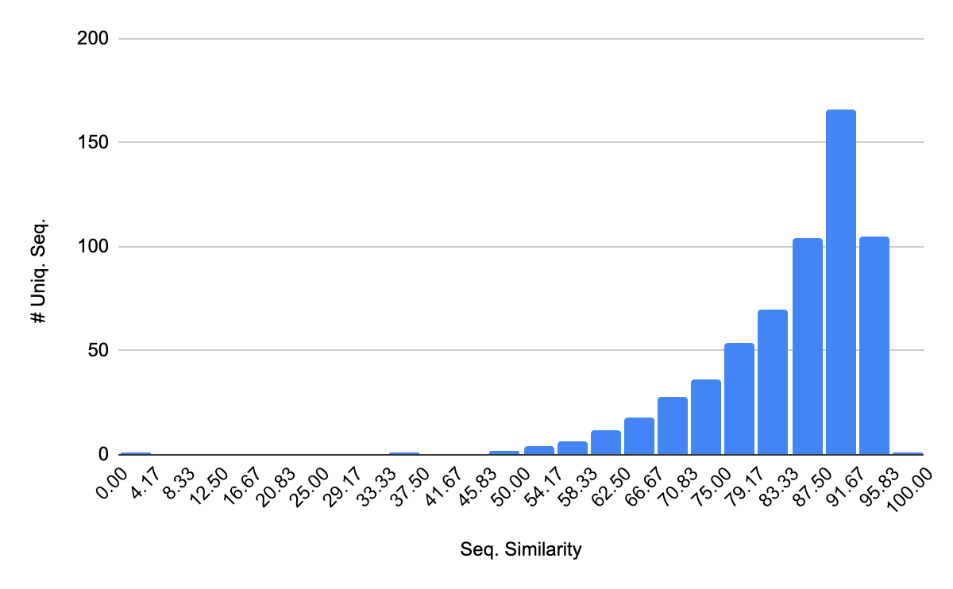
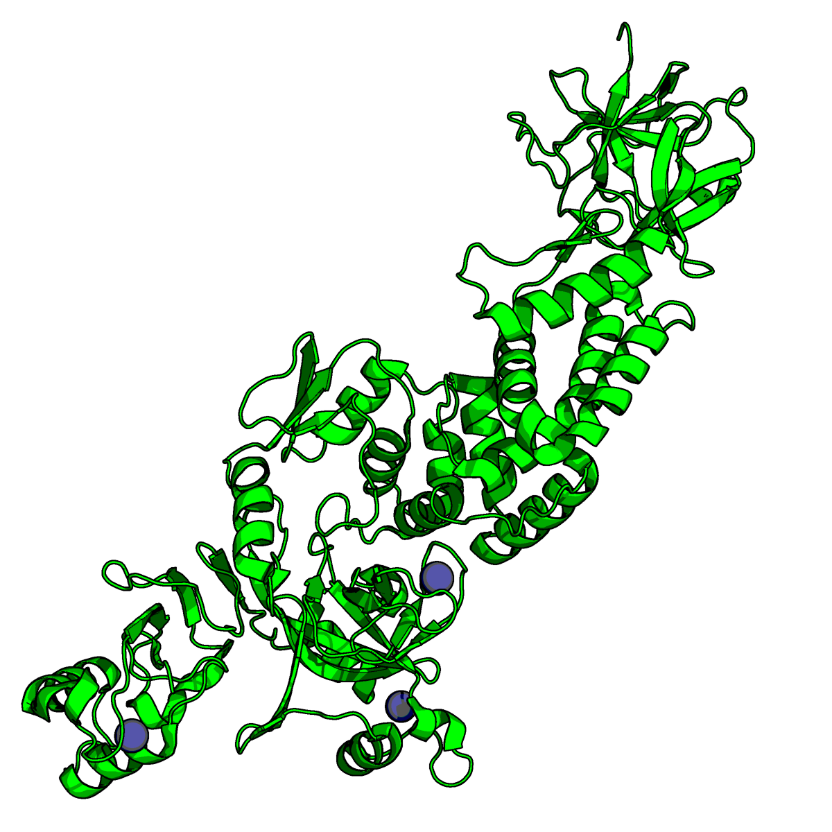
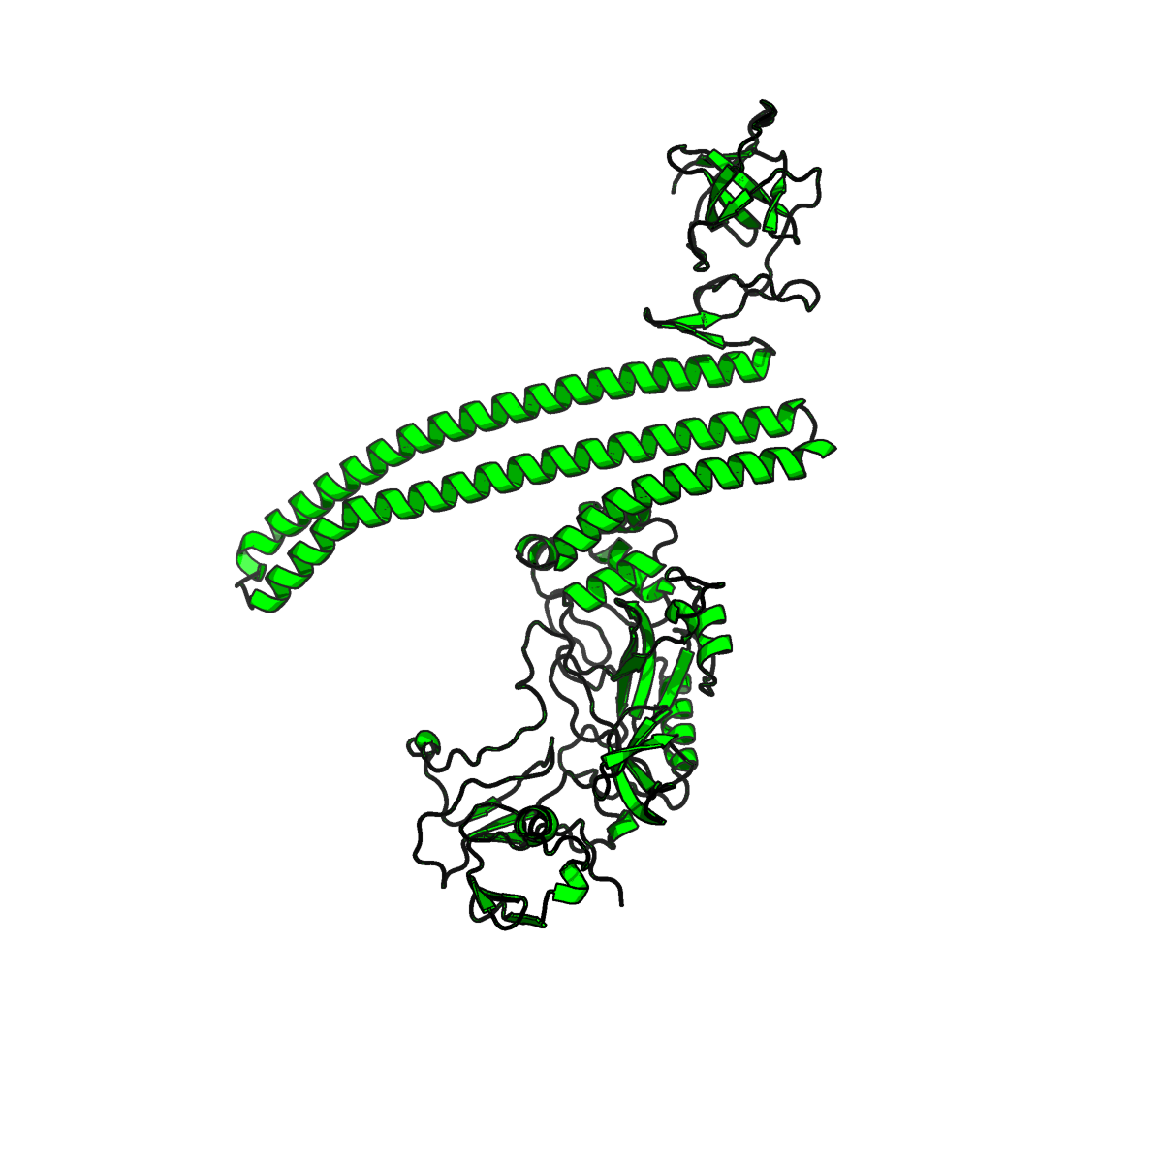
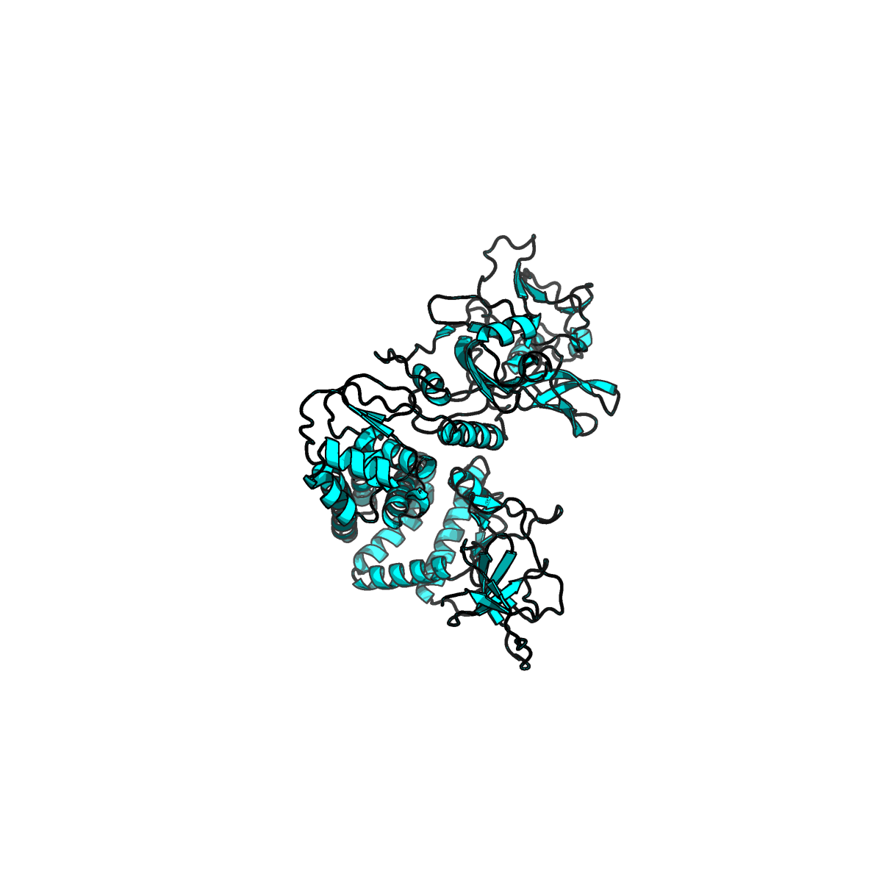
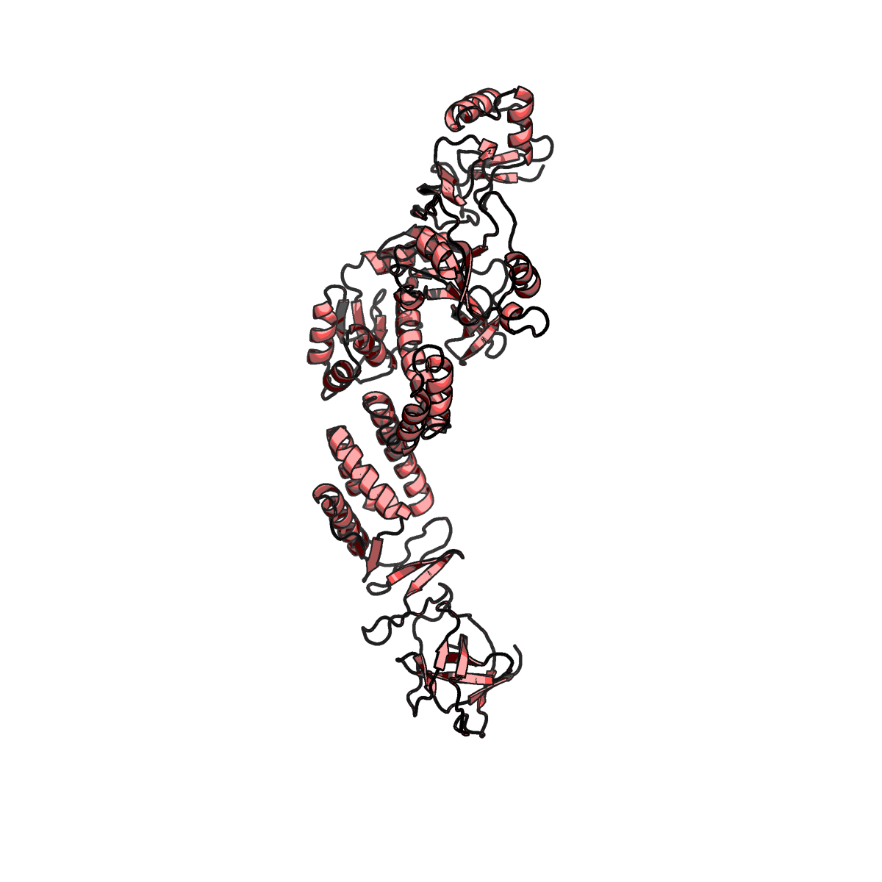
Integrating generative AI and solution data for complementary ensembles
Reduced MSAs to diversity structures
Generative AI is environmentally agnostic when constructing models
n=8,16,24,32
Filter on pTM/iPTM
Random draw of n sequences
Derive physical restraints for modelling/MD
‹#›

Slide 16
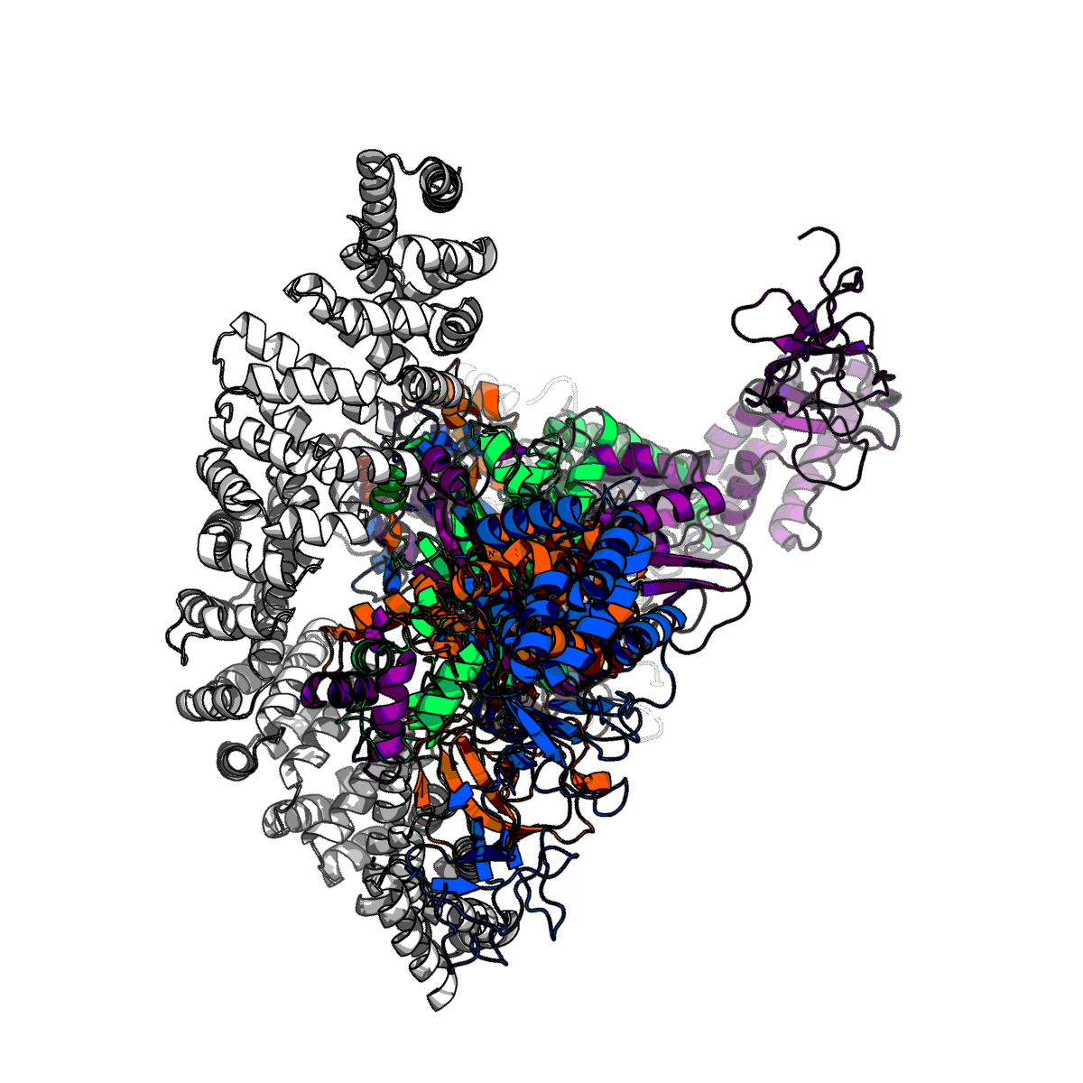
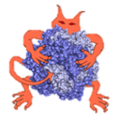
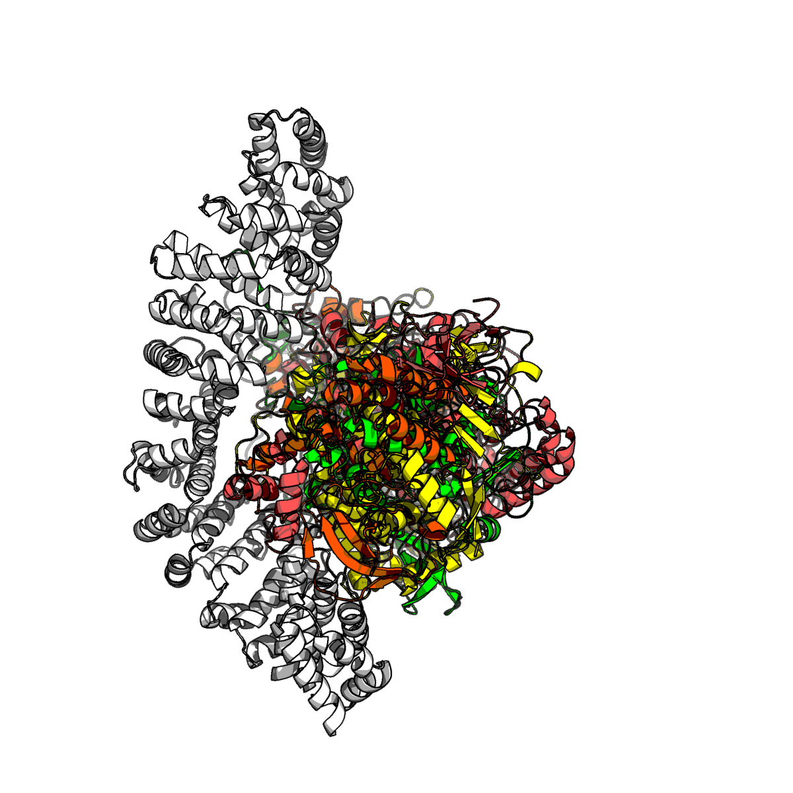
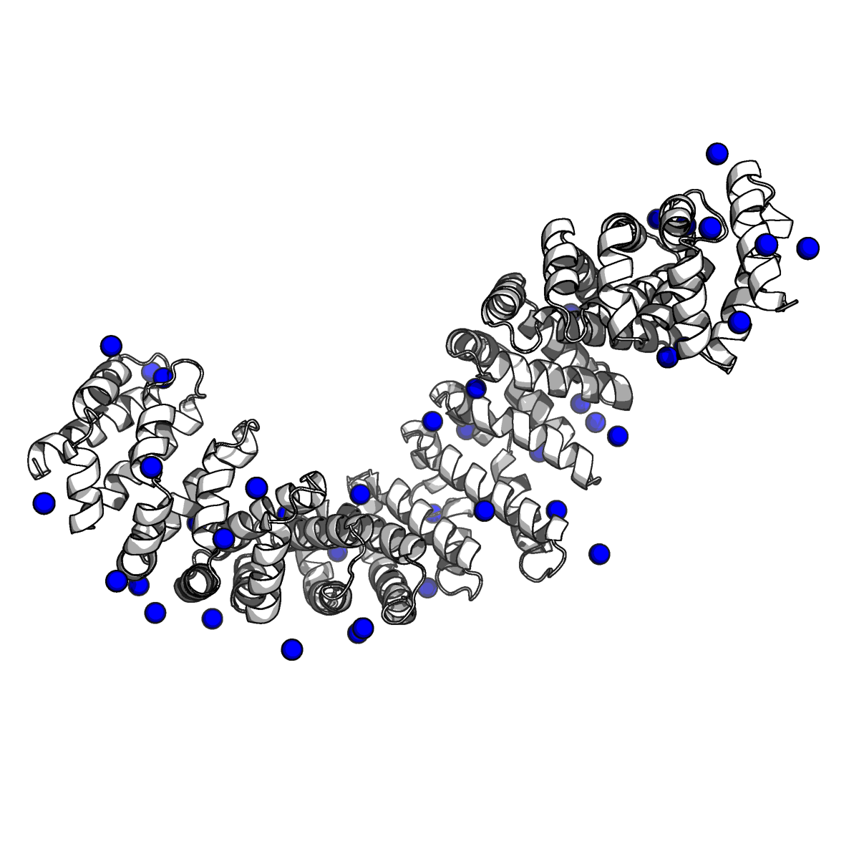
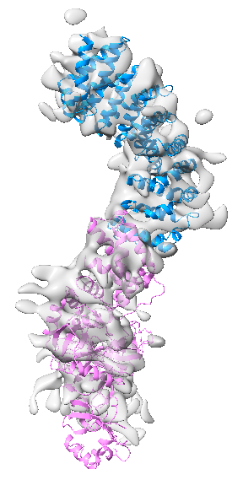
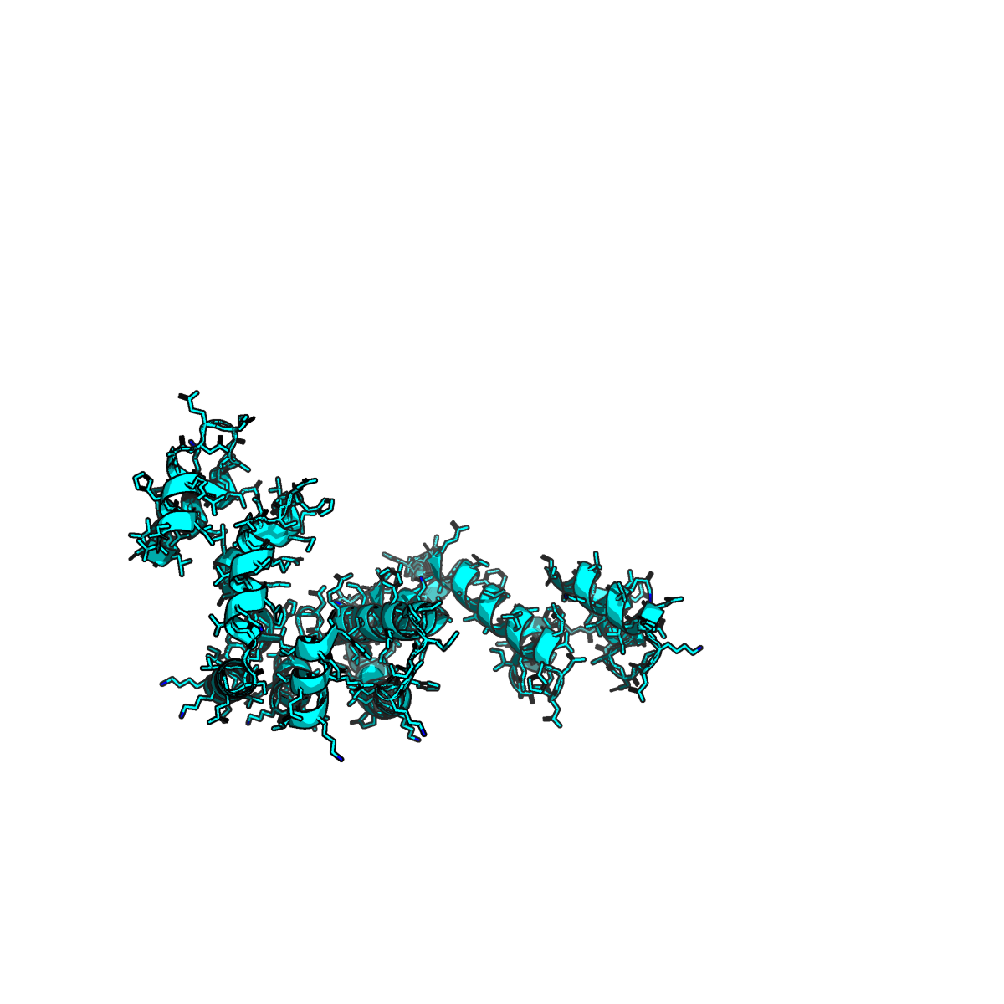
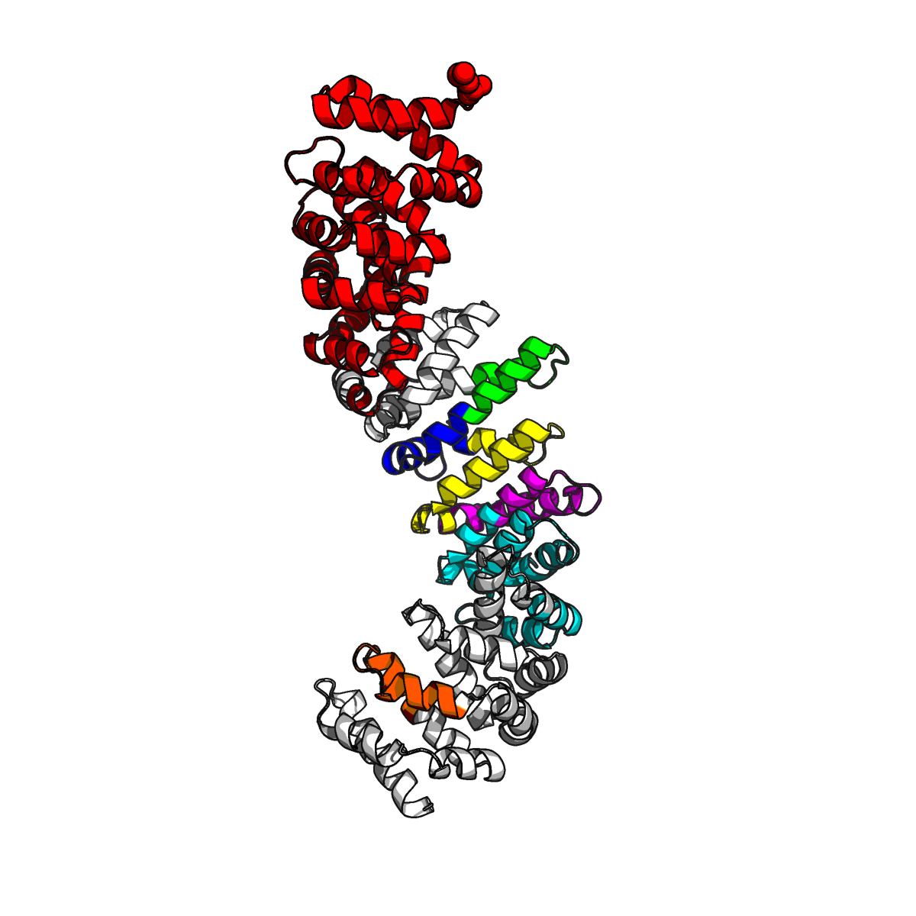
Integrating generative AI and solution data are for complementary ensembles
Generative AI
Sub-sample MSAs
(ColabFold, AF3)
Evaluate and score models for satisfaction
XL|HDX-MS
Truncation constructs
cryo-EM

