Slide 1
PROPEL: Literature Review
UCSF

Slide 2
Purpose
To expand your scientific background
To learn how to precisely formulate a scientific question
To learn how new knowledge is generated through experiments
- experimental design
- scientific logic
Notes:
Students with some breadth in their scientific knowledge and who have the versatility to analyze different types of scientific problems are very appealing to graduate schools because these students have the best potential of excelling as knowledge explorers
Half the battle in science is figuring out what question to ask and asking it in a precise manner that automatically tells you the fundamental experimental strategy you need to answer the question.
In college you learn new knowledge from reading or hearing about conclusions that other people have generated. In graduate research you will be the one generating new knowledge. Papers provide an opportunity to witness and learn how to generate new knowledge by applying a combination of experimental design and scientific logic to answer scientific questions.

Slide 3
Logistics
A required PROPEL activity with attendance taken
You will be assigned to one of four groups
Each group meets one session a month for 9 months from Oct to Jun
Thursdays 4-5 pm (specific dates depending on group)
Parnassus or Mission Bay campus (depending on group)
led by graduate student teaching assistant (TA)
One first year PROPEL scholar will present the paper in each group session
36 presenting slots available
sign up on Google Sheets or be assigned a slot
make sure you have no scheduling conflict
Notes:
TODD: what is our definition of first year propel students? Should we just have a list of those students so there is no ambiguity among the students?

Slide 4
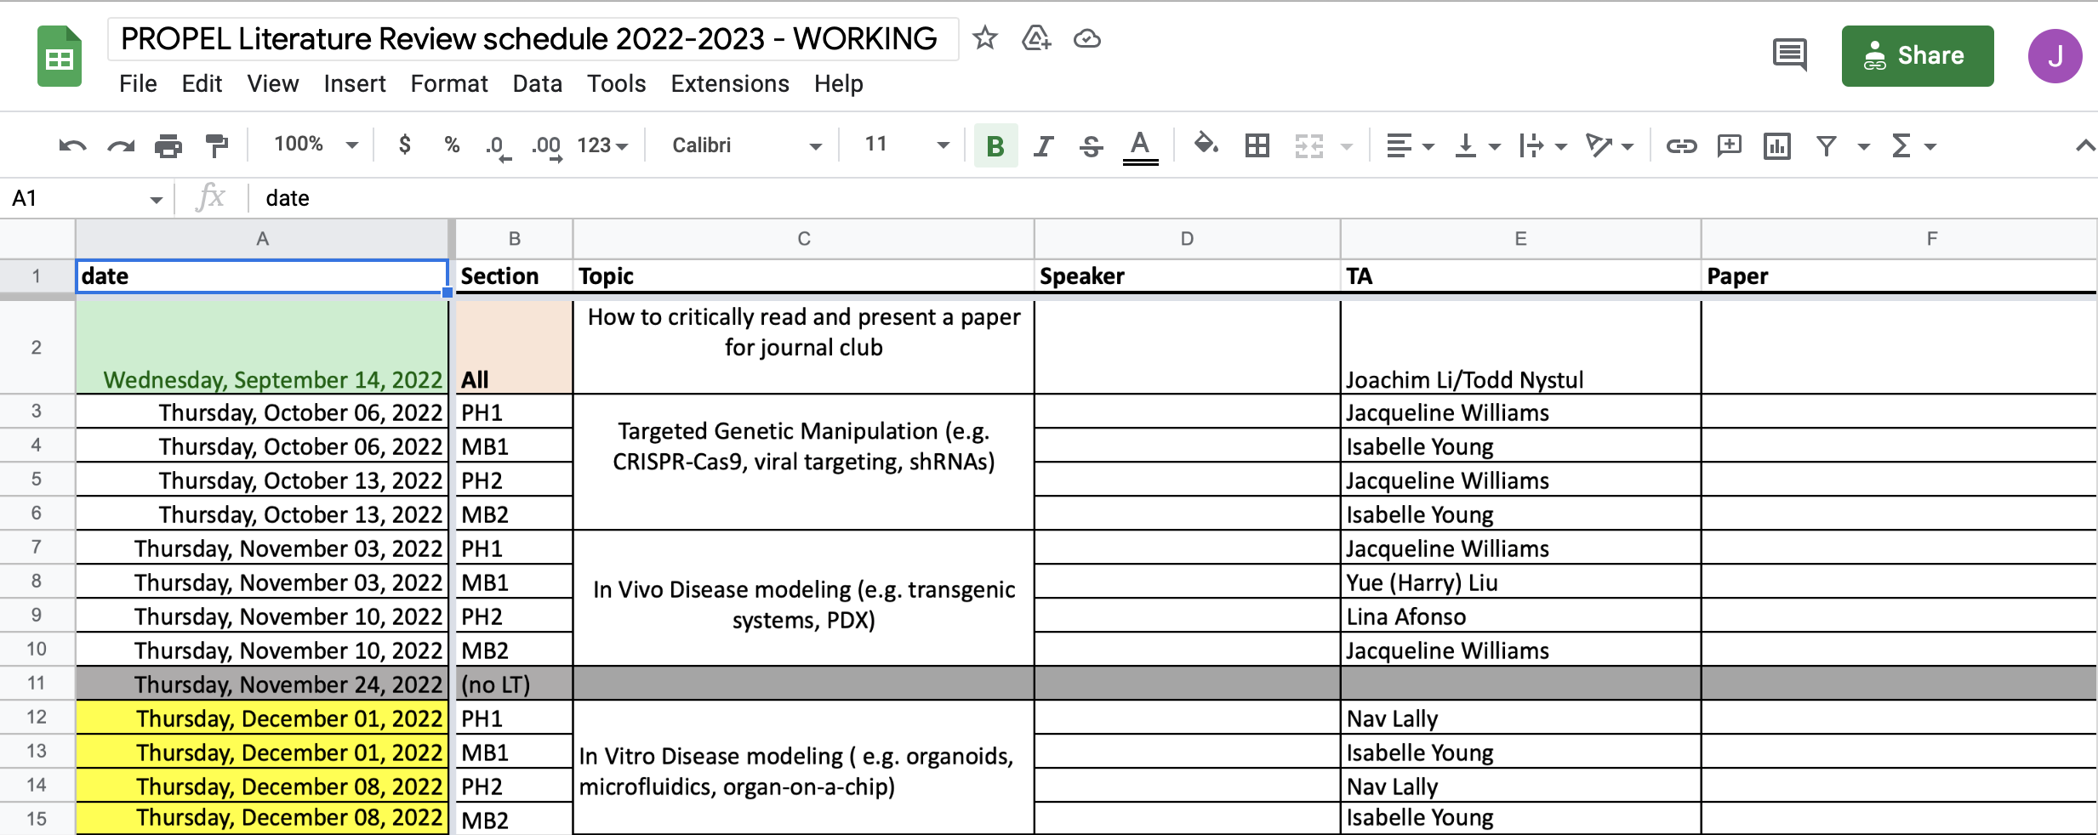
Logistics

Slide 5
Expectations Before Session
All students: read paper carefully well before each session
Senior students: submit a question about each paper on Google Sheets
what do you want to understand more about that was not already asked?
due a week before each session so answers can be prepared
students are encouraged to try posting answers to questions
First-year student presenting:
start 3 weeks in advance and work with TA
First-year student NOT presenting
welcome, but not required, to submit questions (anonymously, if preferred)

Slide 6
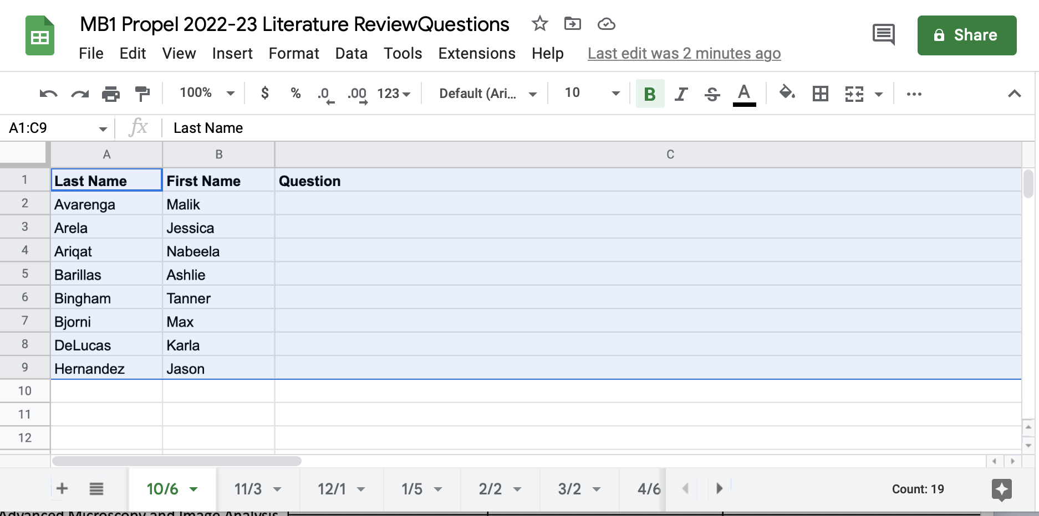
Expectations Before Session

Slide 7
Expectations During Session
Arrive promptly and prepared to session
If you cannot make a session, email an explanation to Joachim Li (joachim.li@ucsf.edu), who give you a makeup session.
Be respectful
Senior students please support presenting student by being extra willing to engage in active discussion

Slide 8
How to read a paper—step 1

Slide 9
What is the key question?
Look for this in Abstract and/or Introduction (often last paragraph)
What do we observe in biology or during a biological process? (observation/description)
Is there an association between certain molecules and/or processes?
this can identify molecule, cells, or factors that work together
this can raise the possibility of a causative relationship
Is there a causative relationship between certain molecules and/or processes
Is one factor necessary for the other?
Is one factor sufficient for the other?
The type of question will determine the experimental design

Slide 10
How to read a paper—step 2

Slide 11
Why is this question important?
Look for this in Introduction (and sometimes Discussion)
What biological process are we trying to understand?
What do we already know about this process?
What key factor(s) is missing from our understanding?

Slide 12
Experimental Design:
Overview discussed in Results with details explained in Methods
Notes:
Science always starts with observations of nature. Some papers simply ask what does nature do.
But more often a paper may start with an interesting observation then develop it into a story involving associations or causation

Slide 13
Experimental Design: Observational
What are you observing? For example:
the position of atoms in a macromolecular structure?
the number or position of a class of molecules in or outside of cells?
the changes in number and fate of cells?
Are you making the observations across space or time?
How does observations about this parameter inform you about the biological process you are observing?
Notes:
Science always starts with observations of nature. Some papers simply ask what does nature do.
But more often a paper may start with an interesting observation then develop it into a story involving associations or causation

Slide 14
Experimental Design: Association
What is the association between?
objects (e.g. molecules, cells, organelles, patients)
events (e.g. biological processes, patient outcomes)
What type of association is being characterized?
physical
locational
temporal
How are specific associations distinguished from random ones?
Notes:
Physical associations usually require some attractive force that makes things “stick” together

Slide 15
Experimental Design: Causation
What are the two factors whose causative relationship are being tested?
If hypothesis relates A and B, what exactly are A and B?
Is the hypothesis: A is necessary for B?
Basic design: eliminate A; ask if that disrupts B
How is A being eliminated? How is B being monitored?
Is the hypothesis: A is sufficient or B?
Basic design: impose A when or where A and B are normally absent
Ask if B appears
How is A imposed? How is B monitored?
Notes:
Two fundamental types of causative relationships: necessity and sufficiency
But actually several combinations of these relationships are possible
A can be necessary but NOT sufficient for B
A can be sufficient but NOT necessary for B
A can be BOTH necessary and sufficient for B

Slide 16
Methods
Usually found in Methods section but sometimes also in Figure Legends
Some methods are used to detect and measure biological parameters
- how is a component or process distinguished or highlighted in a
complex mixture (separation, labeling, or probing)?
Some methods are used to perturb biological processes, e.g.
- disrupting or altering process
- imposing process when/where it is normally absent
- is the perturbation constitutive or conditional?
- physically separate a process or its components (purify)
Can you explain how each method used in the paper works?.
Notes:
Examples of dealing with complex mixtures
Separation: filtration
Labeling: radioactive isotopes, epitope tags, fluorescent tags
Probing: antibody binding, nucleic acid hybridization by complementation

Slide 17
Assays
Often in Methods, but if special or new may be described in Results
All biological processes involve multiple biological functions.
Assays provide a precise experimental method to define and quantify these functions
Assay often detect changes in the measurement of a biological parameter
- action potential assays measure changes in membrane potential
- transcriptional assays measure changes in mRNA levels
Can you identify all the various assays used to monitor different functions?
Can you explain how each assay works?
Notes:
Key point: when you read about a biological function in a paper you should immediately think, what is the assay used to define and measure this function
Most assays are quantitative.
There are important questions of whether the assays are properly applied so that the quantities are meaningful
is the assay readout ”linear” with respect to some parameter you may vary in the assay
Is the assay sensitive enough to detect weak signals
Is the assay specific to the function you are really interested in studying or can the read out be generated by other functions

Slide 18
How to read a paper—step 3
Notes:
Key point: when you read about a biological function in a paper you should immediately think, what is the assay used to define and measure this function
Most assays are quantitative.
There are important questions of whether the assays are properly applied so that the quantities are meaningful
is the assay readout ”linear” with respect to some parameter you may vary in the assay
Is the assay sensitive enough to detect weak signals
Is the assay specific to the function you are really interested in studying or can the read out be generated by other functions

Slide 19
Data Analysis and Interpretation
Usually in Methods and Figure Legends with conclusions in Results
What specific question is being asked in each figure or table
What is actually presented in each figure and table?
do you know what quantity is plotted on each axis of a graph?
How is the raw data converted to the data presented in each figure or table?
What can you conclude from each figure and table

Slide 20
How to read a paper—step 4

Slide 21
Ramifications and Implications
See Discussion but learn to make your own assessment
Did the paper adequately address the scientific question that was posed?
Are there caveats or limitations due to experimental design or execution?
Could there be other conclusions consistent with the results?
How much did this paper advance our understanding of the biological process?
What might you consider the key result or figure?

Slide 22
Questions?

